Slide 1
Applying through
UCAS
Security marking: PUBLIC

Slide 2
Contents
By the end of this presentation, you will:
know what resources are available to support you
understand how to apply
know when you need to submit your application
understand how to track your application and reply to offers

Slide 3
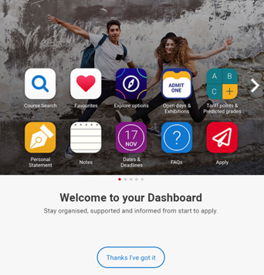
Before you apply…
Register in the UCAS Hub to explore your options, such as:
find and favourite over 35,000 courses
search for virtual tours and online events
turn predicted grades into Tariff points
Go to: ucas.com/hub

Slide 4

Research – it’s free!
Learning from others – student videos and blogs.
Career options – use the job profiles to explore different career roles and pathways, or take the Buzz quiz to find out more about individual strengths, and what roles may suit you.
The Career Finder tool is ideal for considering options after education, including searching for apprenticeships.

Slide 5
Choosing the right university for you
Style – from the traditional, with a focus on subject-based courses and research, to modern universities, with a greater focus on vocational courses.
Location – some are based in large cities, others in smaller towns. This can have a major influence on the environment and lifestyle on offer.
Size – larger universities can have more than 20,000 students, whereas some of the smallest have only a few thousand.
Culture and facilities – influenced by a range of factors, including the diversity of students who attend.
What graduates do – all universities collect destination statistics. It can be interesting to find out the types of jobs or further study students go on to.
Tuition fees – can vary between course providers. Check if there are any scholarships or bursaries available.
Living costs – accommodation, transport, and food can vary enormously.
Notes:
Which modules are the most interesting and relevant to applicants career aspirations?
How many lectures are there and how much group work will be done in seminars?
What combination of exams, coursework or presentations is the course assessed by?
Who are the tutors and are they experts in areas the applicant wants to learn about?
What subject areas do they specialise in?
Can applicants study abroad or get help with work placements?
Do they have sports facilities or societies to join?
How near home, a city center or the countryside are they?

Slide 6
Choosing the right course for you
What does the course cover?
Courses with the same title may be very different.
Look carefully at the core course content, and the range of optional studies/modules available.
Which modules are the most interesting and relevant to your career aspirations?
See if the course or university/college offers any internship, placement, or study abroad opportunities.
How is the course taught – structured teaching, or more independent research? How many lectures are there, and how much group work will be done in seminars?
How is the course assessed?

Slide 7





Apply key facts…
Simple application cost:
  one choice – £20
  two to five choices – £26
It’s an online application.
5
Maximum of five choices.
Equal consideration.
Choice restrictions:
medicine, veterinary, medicine/science, dentistry
(maximum of four)
Oxford or Cambridge
‘Invisibility’.

Slide 8
When to apply for 2021 entry
19 May UCAS Undergraduate Apply opens for 2021 entry.
8 September First day for receipt of completed applications.
15 October* Application deadline for courses in medicine, veterinary medicine/science, and dentistry, and courses at Oxford or Cambridge.
15 January* Equal consideration application deadline.
25 February Extra opens.
30 June* Last date for applications before Clearing.
* All 18:00 (UK time)

Slide 9
Making a UCAS application
Begin at ucas.com/apply.
Sections to be completed:
Personal details
Choices – make up to five
Education
Employment
Personal statement
Reference
Notes:
To register with Apply takes 10 minutes, and you are able to log in and out of the form as much as you want to complete it.
UCAS sends an application to universities and colleges within 24-48 hours.

Slide 10
The personal statement
The only section you have full control over
Your only chance to market themselves individually
A maximum of 4,000 characters, or 47 lines
The same for all of your choices
A minimum of 1,000 characters
There isn’t a spelling or grammar check
No formatting is allowed
UCAS’ similarity detection service:
every personal statement is run through software to check for plagiarism.

Slide 11
Start early
Include:
  academic achievements, past and present
  why you’re interested in the subject area
  your knowledge of the subject area
  your enthusiasm to go beyond the syllabus
  what you enjoy about studying
  details of your independent study skills

Slide 12
Consider…
  Universities and colleges will ask:
  Have you chosen the right subject for the right reasons?
  Can you survive in an intense and pressured atmosphere?
  Do you have a range of interests and aptitudes?
  Do you have a depth of interest in the subject?
  Have you studied independently?
  Do you appear motivated and committed?
  Do you possess good numeracy and literacy skills?

Slide 13
Decision-making
After receiving your application, a university or college will make one of three decisions:
  unconditional offer
  conditional offer
  unsuccessful
  Or, they can offer a place on an alternative course.
Universities and colleges can also:
request an interview
ask to see your portfolio
ask you to take an admissions test

Slide 14
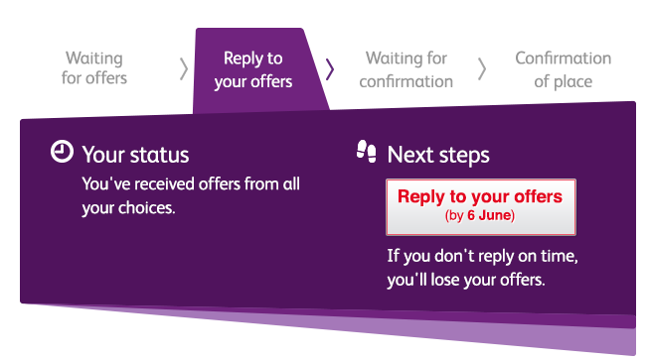

Tracking applications
Track allows applicants to:
follow the progress of their application 24/7
see their choices and personal information
view their offers
reply to offers online
In Track, a student can hold up to two offers:
  firm – if they meet the conditions of the offer they will be placed here
  insurance –if they are not placed with their firm choice, they may be placed with their insurance choice
Notes:
If an applicant does not receive offers at the same time as their friends – this is normal. Each institution makes offers in different ways and at different rates.

Slide 15
Replies to offers
Once you have decisions on all your choices, you can hold a maximum of two offers:
  one as a ‘firm’ acceptance – your first choice
  the other as an ‘insurance’ acceptance. This acts as a back-up if you do not get into your ‘firm’ choice
You must then decline any remaining offers.
Once all your decisions and replies have been made, if you are not holding an offer, you may be able to use Extra or Clearing to find available places. See www.ucas.com for more information.
Notes:
You do not have to have an insurance choice if you are certain you would only be interested in one of your offers.
You cannot swap between the insurance and firm choices.
The insurance choice disappears once you have been placed with your firm choice.

Slide 16

Other options
Extra (25 Feb – 4 Jul)
  Used all five choices and had no offers.
  Add Extra choices for consideration one at a time in Track.
Clearing (5 Jul – 19 Oct)
Apply after 30 June, receive no offers, decline all offers, not met conditions.
Find vacancies from July, and add one choice in Track.
Adjustment (up to five days in Aug)
Placed with firm choice, and did better than expected.
Register in Track, then find another university or college. The new university or college adjusts the record.

Slide 17


Additional help
UCAS Customer Experience Centre
0371 468 0 468
From outside the UK:
+44 330 3330 230
Monday to Friday, 08:30 – 18:00 (UK time)
Find us online at:
facebook.com/ucasonline
twitter.com/UCAS_online

Slide 18
Thank you

