Slide 1
Paper 1 Mock Exam – Jan 2021
Your exam will be the full 2hrs15min 105marks, but will be adapted so that it does not include any questions on CARBON. The entire final section will be solely about water for this mock. All sections will carry the same number as the actual paper 1.
Tectonics - 16 Marks
10-15% of your revision time
Learn/Remember the content
PRACTICE APPLYING IT
Coasts - 40 Marks
40-45% of your revision time
Learn/Remember the content
PRACTICE APPLYING IT
Water (usually water & carbon) – 49 Marks
50% of your revision time
Learn/Remember the content
PRACTICE APPLYING IT
YOU ARE ADVISED TO FOCUS YOUR REVISION AROUND COASTS AND WATER GIVEN THE MARKS AVAILABLE. TECTONICS REVISION WOULD BE BEST FOUCSED AROUND IMPACTS AND MANAGEMENT AND THE FACTORS THAT AFFECT THESE.
The following slides have been separated into revision activities/notes for each topic and PPQs. They do not cover absolutely everything. Use them in conjunction with the specification and your text books to support your revision.
Spec: https://qualifications.pearson.com/content/dam/pdf/A%20Level/Geography/2016/specification-and-sample-assessments/Pearson-Edexcel-GCE-A-level-Geography-specification-issue-5-FINAL.pdf

Slide 2
Tectonics Revision Activities & Notes

Slide 3
Topic 1: Tectonic Processes and Hazards
Enquiry question 3: How successful is the management of tectonic hazards and disasters?
1.7: Understanding the complex trends and patterns for tectonic disasters helps explain differential impacts.
1.8: Theoretical frameworks can be used to understand the prediction, impact and management of tectonic hazards.
1.9: Tectonic hazard impacts can be managed by a variety of mitigation and adaptation strategies, which vary in their effectiveness.
Enquiry question 1: Why are some locations more at risk from tectonic hazards?
1.1: The global distribution of tectonic hazards can be explained by plate boundary and other tectonic processes.
1.2: There are theoretical frameworks that attempt to explain plate movements.
1.3: Physical processes explain the causes of tectonic hazards.
Enquiry question 2: Why do some tectonic hazards develop into disasters?
1.4: Disaster occurrence can be explained by the relationship between hazards, vulnerability, risk and disaster.
1.5: Tectonic hazard profiles are important to an understanding of contrasting hazard impacts, vulnerability and resilience.
1.6: Development and governance are important in understanding disaster impact and vulnerability and resilience.

Slide 4
Tectonics
Nepal – April 2015, magnitude 7.8: Vulnerability
Developing country (26.5 million).
9000 people died, 22,000 injured, over half a million homes collapsed/
Why? Multiple hazard zone (landslides, floods), limited technology / preparation, seismic hazard map is 20 years old, Kathmandu Valley – 2.5 million, very high population density (13,000 km2) and growth rate (4% yr), 85% live in rural areas with reliance on primary industry.
Vulnerable – socially excluded groups, poverty, self-built homes.
Bam – January 2003, Southern Iran: Vulnerabilty
Upper middle income country (75/187).
Magnitude 6.6 (on average 1 a week worldwide)/
26,000 people died.
Why? Shallow hypocentre of 7km, 5.26am, vertical direction of shaking = maximum damage to buildings, ancient city, poor quality construction of recent buildings, 3 main hospitals destroyed, 20% of healthcare professionals killed, emergency services struggled, cold.
Developing Country – Haiti 2010: Port-au-Prince (25km from epicenter), magnitude: 7.0, focus: 13km deep on a conservative plate boundary, population 2.5 million.
Primary: 316 000 people died , 300 000 were injured, 1 million people made homeless, the port, communication links and major roads were damaged beyond repair, rubble from collapsed buildings blocked road and rail links.
Secondary: water supply system was destroyed – a cholera outbreak killed over 8000 people, port was destroyed – making it hard to get aid to the area, Haiti’s important clothing factories were damaged. These provided over 60% of Haiti’s exports. 1 in 5 jobs were lost, 2015 most people displaced by the earthquake had been re-housed.
80% of education in Haiti was provided in often poor-quality private schools, the state system generally provided better education but provided far too few places
Half of people in Port-au-Prince had no access to latrines and only one-third has access to tap water
New Zealand – 2010 / 11: Resilience
Sept 2010 & Feb 2011 – Canterbury (South Island) hit by a series of major earthquakes.
Caused loss of life & destruction, however economy was resilient.
Why? Disruption to manufacturing / industry short lived, agricultural sectore unaffected, rebuild costs (US$15 billion) mostly covered by insurance.
However, tourism industry suffered – international visitors were down 40% in 2011-2012.

Slide 5
Tectonics
Developed Country – Japan – Tohoku, 2011: magnitude: 9.0, focus: 30km deep on a convergent plate boundary, epicentre: 70km from the coast in Sendai Bay.
Primary: 1 dam collapsed, 2 nuclear power stations fractured, and an oil refinery set on fire by damaged gas pipes, Tohoku motorway badly damaged in northern Japan. Sendai airport closed by the tsunami. One rail link near Sendai badly damaged. US$ 235 billion of damage caused by earthquake and tsunami combined - the costliest disaster in history.
Secondary effects (caused by the tsunami): 15 900 people died, 2600 missing, 6150 injured, 350 000 homeless. Most were at work or school when it struck at 2:46 pm. 93% of deaths caused by drowning. Two nuclear reactors went into meltdown because flooding damaged the cooling systems. Local people were evacuated and had not returned by 2015. Businesses disrupted by damage, clearance and rebuilding. Homelessness, disrupted schooling, unemployment and increased stress lasted for years as the authorities struggled to cope with damage.
Prediction: The Japan Meteorological Agency (JMA) and local governments monitor seismic activity all over the country. If an earthquake is detected, people are warned immediately.
Preparation: Strict building laws, buildings reinforced with steel frames, high-rise buildings have deep foundations with shock absorbers, early warning systems, high-speed 'bullet' trains automatically brake, automatic alarms stop mechanical equipment to alert workers and prevent injuries.
Developing Country – Philippines, Mt Pinatubo (1991): Eurasian plate is subducting beneath the Philippine plate. After more than 600 years of inactivity Pinatubo erupted on the 12th June 1991.
Primary: Steam and ash was sent 30km up, pyroclastic flows (200km per hour), 847 people killed, ash cloud stopped rescue teams, 5000 homes destroyed , 70,000 damaged, buildings collapsed, people were displaced to shanty towns in the capital Manila, power supplies cut, roads / bridges were unusable, local water supplies were contaminated.
Secondary: global temperatures dropped by 0.5⁰C temporarily, hundreds of people died from disease mainly measles, pneumonia and diarrhoea in evacuation camps, crops were destroyed as ash covered 800km² of rice fields, 800,000 farm animals were killed, with the cost to farmers estimated at 1.5 billion pesos (£20 million), lahars were created up to 3m high
Prediction: aadvanced warnings allowed thousands of people to evacuate, swarms of earthquakes beneath the volcano in detected in March 1991, tiltmeters detected rock deformation. Helicopters with gas measuring technology flew over Pinatubo daily, ggeologists mapped previous lava flows and lahars to estimate areas at most risk, warnings were issued and locals were evacuated in advance.

Slide 6
Tectonics PPQs

Slide 7
1. Study Figure 1. Analyse the global pattern of the distribution of active volcanoes. (4 marks)
The key points you need to pick out from the map include: • Most active volcanoes lie on or near plate margins. • Especially around the Pacific Ocean (Pacific Ring of Fire), e.g. Mount Rainier. • Some lie in the middle of plates at hot spots above mantle plumes, e.g. Mauna Loa. Hints and tips Systematically break down the elements of the map to draw out the patterns.
Example B:
Volcanoes are found in many parts of the world including North America (Mount St Helens), Europe (Vesuvius), Asia (Fujiyama) and South America (Cotopaxi). There are also volcanoes in oceans including Tristan da Cunha and Kilauea.
Example A: Figure 1 shows that the majority of the world’s active volcanoes are found close to the major plate boundaries across the world. This is especially the case around the Pacific Ocean, where the boundaries at its edge form the Pacific Ring of Fire. Here, active volcanoes such as Mount St Helens in the USA and Fujiyama in Japan are found. In addition, there are some locations away from plate margins where volcanoes occur, especially the likes of Mauna Loa in Hawaii. This sits on a hot spot over a mantle plume.
Examiner comment Although this answer refers to many places on the map, it is too descriptive. A deeper analysis is needed to pick out the patterns. 2 marks.
Examiner comment The overall pattern is stated clearly. Thorough analysis is given of the patterns in the map, which is backed up with examples from the source. 5 marks.

Slide 8
2. Assess the significance of development in the effective response to tectonic mega-hazards. (12 marks)
Level 1 (1–4 marks): You show only a limited geographical knowledge and understanding of the significance of development. You make limited connections between aspects of your answer and support your interpretations with limited evidence. You draw unbalanced conclusions based on the material in your answer. Level 2 (5–8 marks): You show mostly relevant and accurate geographical knowledge and understanding of the significance of development. You make mostly relevant connections between aspects of your answer as appropriate and support your interpretations with some evidence. You draw conclusions based on the material in your answer but your conclusions may be limited or unbalanced. Level 3 (9–12 marks): You show relevant and accurate geographical knowledge and understanding of the significance of development. You make sound connections between aspects of your answer as appropriate and support your interpretations logically with evidence. You draw balanced and logical conclusions based on the material in your answer.
TASK:
1. Read through and assess the example answers.
2. Using the mark scheme read through your partners work, Give them a mark out of 12 and one key target to improve their work.
Examiner comment - B The student shows accurate and generally relevant knowledge and understanding for AO1, although to improve their mark they should include more detail. The student has applied their knowledge and understanding to make some relevant connections between development and impacts, supported by evidence. Overall, however, more connections could be made and the answer is imbalanced between the positive and negative effects of development for AO2. Level 2, 7 marks.
Examiner comment - A The student demonstrates accurate and relevant knowledge and understanding for AO1. They apply their knowledge and understanding to make relevant connections between development and impacts, supported by evidence and with sound judgements to create balanced and coherent arguments for AO2. Level 3, 11 marks.

Slide 9
Some suggested ideas are given below but you may wish to expand on these or include other relevant points. AO1 Demonstrating your knowledge and understanding • Mega-hazards are hazards that produce large-scale impacts. • The effect they have on people is determined to a large extent by the level of development of the country/countries involved.
AO2 Applying your knowledge and understanding • By making relevant connections. • Supporting your evaluation with evidence. • Producing a balanced and coherent argument. Development can negatively affect the vulnerability of people leading up to the hazard, for example: • Unsustainable development increases vulnerability. • Lack of money can result in underinvestment in resilience training for the population. • Issues with social development, e.g. poor health/nutrition levels. Development can also negatively impact the post-hazard situation. • Damage to infrastructure such as homes and services. • Social — damage to provision of health and education. Development can also influence preparedness in a positive way, for example: • Investment in hazard monitoring. • Infrastructure resilience. • Mitigation strategies, e.g. tsunami walls. • Training and preparedness of local population. Following the hazard, there are opportunities for development to positively influence future resilience through, e.g. rebuilding strategies that make buildings more resilient.
Example A:
Mega-hazards cause large-scale impacts, in terms of either the area they cover, or the extent of the impacts on the people involved. In developing and emerging countries, the lower levels of development can have a large effect on how significant the impacts of a hazard are. But where development levels are higher, the impacts of hazards can be reduced. Lower levels of development can negatively affect the vulnerability of the local populations. For example, unsustainable development can increase vulnerability of local people. In Haiti prior to the 2010 earthquake, rapid rates of urbanisation led to the growth of shanty towns in Port au Prince. These buildings were less able to withstand the shaking of the earthquake and many collapsed. Even in the longer-established buildings, lack of proper design and poor construction techniques resulting from poverty caused many of the buildings to pancake as the floors collapsed on top of each other. In addition, lack of money can result in underinvestment in preparing the population to deal with the hazards when they occur. Furthermore, low levels of social development can make a population more vulnerable. If nutrition and health levels are lower to begin with, following an earthquake the population will be more vulnerable to diseases that readily spread in the make-shift camps people set up. For example, in Haiti in 2010, an additional 9,000 people died as a result of a cholera outbreak following the earthquake. Development can affect the response to the threat of hazards in a positive way too. For example, in richer countries money can be invested in monitoring hazards. In Japan before the 2011 earthquake, a network of 182 seismometers constantly monitored the country for signs of seismic activity. These provided the basis for the earthquake early warning system in place there and the tsunami warning system too. Buildings can be made ‘life safe’ in countries with more money. Again in Japan, strict building codes ensured that very few buildings collapsed due to seismic shaking during the 2011 magnitude 9.0 earthquake. Additionally, mitigation strategies can be implemented. The Japanese have a very extensive sea-wall defence against the tsunami threat (although there is evidence that these walls led to complacency among the local population during the 2011 quake, resulting in many thousands of deaths). Overall, then, development can have a significant effect, either positively or negatively, on how effective the response to tectonic mega-hazards is.
Example B:
Mega-hazards occur whenever earthquakes or volcanoes cause impacts on people. A lower level of development can affect the vulnerability of the local populations in a negative way. Unsustainable development can make local people more vulnerable. In Haiti, because of poverty, there was a lack of proper building design and poor construction techniques before the 2010 earthquake. As a result, many of the buildings were flattened as the floors collapsed on top of each other. A lack of money can also result in underinvestment, so that the population is not properly prepared to deal hazard events. And a population is more vulnerable if there is a low level of social development and nutrition and health levels are lower to begin with. Following an earthquake, diseases can quickly spread through make-shift camps that people set up. In Haiti in 2010, for example, a cholera outbreak following the earthquake caused an additional 9,000 deaths. Lack of money also affected the rebuilding programme after the earthquake. By 2016, 60,000 of the 1.5 million Haitians left homeless after the quake were still living in camps. In richer countries, development can have a positive effect. The Japanese have built extensive sea-wall defences against the tsunami threat. However, there is evidence that these walls led to complacency among the local population during the 2011 quake. That resulted in many of them ignoring the tsunami evacuation warnings until it was too late.

Slide 10
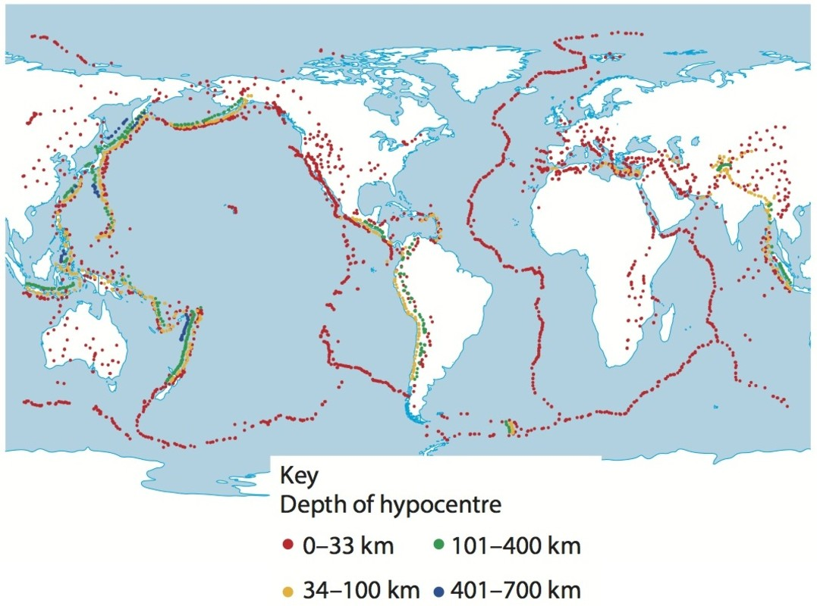
Figure 1: Different depth tectonic earthquake boundaries mapped on to a world map
Study Figure 1. Analyse the pattern of the depth of earthquake hypocentres shown on the map. (4 marks)
Hints and tips Systematically break down the elements of the map to draw out the patterns across the globe.
2. Assess the factors that influence the management of the impacts of earthquake in countries at different levels of development. (12 marks)
Hints and tips Consider the various factors that can affect the impacts, coming to an overall assessment at the end of your essay.

Slide 11
1. Study Figure 1. Analyse the pattern of the depth of earthquake hypocentres shown on the map. (4 marks)
The key points you need to pick out from the map include: • Some plate boundaries consist of mostly shallower hypocentres, such as the Mid-Atlantic Ridge. • Some have shallower and deeper hypocentres, such as the Pacific coast of South America. • The deepest hypocentres are to the west of the Pacific, at East Asia and New Zealand.
Example B: Some plate margins have mostly shallower hypocentres, others have shallow and deeper hypocentres. For example, margins with hypocentre depths of between 0 and 33 km are found in places such as the Mid Atlantic, Europe and the Indian Ocean. The locations that have deeper hypocentres (34–400 km) are found in the Pacific Ring of Fire, surrounding the Pacific Ocean, including off the coast of South America. The deepest hypocentres of between 401 and 700 km are found off the eastern coast of Asia.
Example A: The Atlantic Ocean has shallower hypocentres, around 0–33 km deep. The Indian Ocean has hypocentres of this depth also. South America has hypocentres of between 0 and 400 km deep. North America is between 0 and 100 km deep. Asia has some very deep hypocentres, down as far as 700 km deep. Europe has shallower hypocentres — mostly 0–33 km deep.
Examiner comment Although this answer refers to the source and quotes figures, it is too descriptive. To ‘analyse’ means to draw out the patterns, not simply state what is happening. To improve their mark, the student should look for patterns and relationships in the map. 2 marks.
Examiner comment The student states the overall pattern clearly. Thorough analysis is given of the patterns in the map, which is backed up with examples from the source. 4 marks.

Slide 12
2. Assess the significance of development in the effective response to tectonic mega-hazards. (12 marks)
Level 1 (1–4 marks): You show only a limited geographical knowledge and understanding of the factors affecting the management of the impacts. You make limited connections between aspects of your answer and support your interpretations with limited evidence. You draw unbalanced conclusions based on the material in your answer. Level 2 (5–8 marks): You show mostly relevant and accurate geographical knowledge and understanding of the factors affecting the management of the impacts. You make mostly relevant connections between aspects of your answer as appropriate and support your interpretations with some evidence. You draw conclusions based on the material in your answer but your conclusions may be limited or unbalanced. Level 3 (9–12 marks): You show relevant and accurate geographical knowledge and understanding of the factors affecting the management of the impacts. You make sound connections between aspects of your answer as appropriate and support your interpretations logically with evidence. You draw balanced and logical conclusions based on the material in your answer.
TASK:
1. Read through and assess the example answers.
2. Using the mark scheme read through your partners work, Give them a mark out of 12 and one key target to improve their work.
Examiner comment The student shows accurate and generally relevant knowledge and understanding for AO1, although to improve their mark they should include more detail. The student has applied their knowledge and understanding to make some relevant connections between development and impacts, supported by evidence. Overall, however, more connections could be made and the answer is imbalanced between the positive and negative effects of development for AO2. Level 2, 7 marks.
Examiner comment The student demonstrates accurate and relevant knowledge and understanding for AO1. They apply their knowledge and understanding to make relevant connections between development and impacts, supported by evidence and with sound judgements to create balanced and coherent arguments for AO2. Level 3, 11 marks.

Slide 13
Coasts Revision Activities & Notes

Slide 14
Littoral zone
The littoral zone is the wider coastal zone, including coastal land areas and shallow parts of the sea just offshore.
It can be divided into the coast, backshore zone, foreshore, nearshore and offshore.
Geological structure
There are 3 elements to geological structure
Strata – the different layers of rock exposed in a cliff
Deformation – tilting and folding by tectonic activity
Faulting – major fractures that have moved rocks from their original positions
Geological structure produces 2 main types of coast:
Concordant – when rock strata run parallel to the coastline – An example is the discordant coast of West Coast Ireland
Discordant – when different rock strata intersect the coast at an angle so rock type varies along the coastline. An exmaple is Lulworth cove on the south coast of England, or the Dalmatian coast in the Adriatic Sea
Discordant coasts - Dominated by headlands and bays
Sediment Transportation | Pebbles, cobbles and boulders are rolled along the sea bed by the waves and currents (traction), sand size particles are bounced due to the force of water or wind (saltation), sand grains are carried in the water(suspension), calcium from limestone and chalk rocks dissolves and is carried in solution (solution).
Attrition | Occurs when pieces of material are moved by the waves and knock into each other. The material gets smaller and rounder, eventually turning into sand.
Abrasion | Occurs on a cliff, or other exposed area of rock, when waves puck up sand and pebbles and throw and scape them against the rick surface. This wears away the rock in an action similar to sandpaper on wood
Hydraulic action | Occurs when large waves break against a cliff. When this happens they compress air into the cracks. When the water falls away the compressed air is suddenly released explosively shattering the rock around the crack making it bigger.
Solution (Corrosion) | Occurs when sea water dissolves some of the rock minerals, causing the disintegration of the rock. Limestone rocks are affected the most by this process
Constructive and Destructive waves
Constructive waves:
Low wave height (less than 1m) and long wavelength (up to 100m)
Strong swash that pushes sediment up the beach and weak backwash that drains into the beach sediment
Destructive waves:
Have a height of over 1m and wave length around 20m.
Have a strong backwash that erodes beach material and carries it offshore, creating an offshore ridge
Rocky Coasts
Many coastlines consist of rocky cliffs that vary in height. High relief cliffs tend to be relatively hard rock.
There are 2 main cliff profile types:
Dominated by marine erosion – wave action dominates, cliffs tend to be steep, unvegetated, little debris at the base of the cliff.
Dominated by subaerial processes - not actively eroded at the base of the cliff by the waves, shallower, curved slope, lower relief, surface run-off erosion and mass movement are responsible for the cliff shape
Coastal vegetation
Some coastlines including sand dunes, salt marshes, and mangrove swamps are protected from coastal erosion by the stabilising influence of plants.
How vegetation stabilises coastal sediment:
Roots bind sediment
When submerged, plants provide a protective layer so the sediment surface is not directly exposed
Plants protect sediment from erosion by wind, reducing wind speed through friction.
Erosion Landforms
Erosion produces distinctive landforms e.g. Caves, arches, stacks and stumps. The fundamental process of landform creation on a coastline is the creation of a wave cut notch through hydraulic action and abrasion.
Depositional landforms
Longshore drift is a key source of sediment for depositional landforms. Some key examples of depositional landforms are:
Spit e.g Spurn Head, Holderness Coast
Bayhead beach e.g. Lulworth Cove, Dorset
Tombolo e.g St Ninians tombolo, Shetland
Barrier beach / bar e.g. Chesil Beach, Dorset
Hooked / recurved beach e.g. Hurst Castle Spit, Hampshire
Cuspate foreland e.g .Dungeness, Kent
Coastal plains
Low-lying flat areas close to the coast. Many contain estuary wetlands and marshes. They are just above sea level so are poorly drained. These are low energy environments.
Coastal plains form when:
Sea level falls, exposing the sea bed of a past shallow continental shelf.
Sediment brought from the land by the river systems is deposited at the coast causing coastal accretion e.g a delta
Sediment is moved from offshore sources towards the coast by ocean currents.
Longshore drift | The movement of sand and pebbles along a coast is called longshore drift. Waves approach the coast at an angle The swash carries the sand and pebbles up the beach at the same angle as the wave approaches The backwash then draws the sediment back down the beach at right angles to the coastline The process is repeated resulting in a ‘zig-zag’ movement of sediment along the coast. The direction of longshore drift is generally controlled by the prevailing wind direction.
Winter beach profiles- Destructive waves are more prevalent in winter conditions and so the beach profile takes a destructive plunging wave winter beach profile
Summer beach profile – Constructive waves are more prevalent in summer conditions and so a constructive swell wave summer beach profile occurs.
Variations in beach profile- Beaches have landforms that change constantly
Storm beaches
Berm Ridges
Low channels and runnels
Offshore ridges/bars
Plant succession: Where an area of initially bare sediment is colonised. Pioneer plant species begin to grow on bare sand or mud starting the process of plant succession. Each step in plant succession is called a seral stage. The end of plant succession is called climatic climax community e.g. Sand dune ecosystems and salt marsh ecosystems.

Slide 15
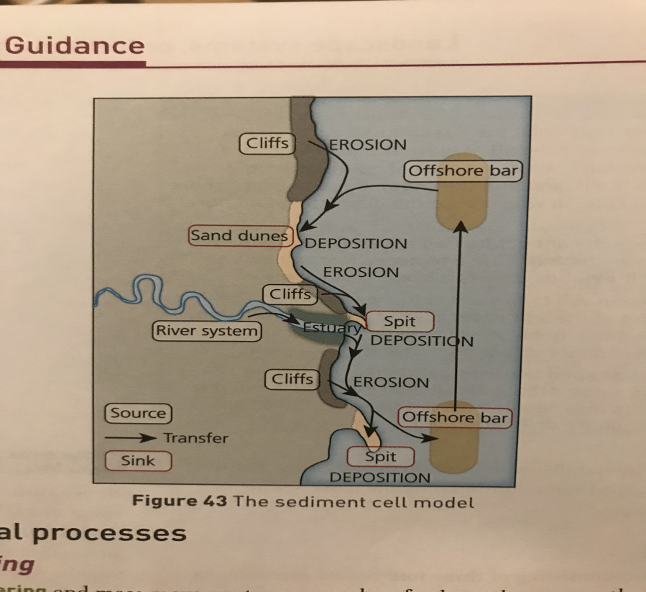
The sediment cell model
Coastlines operate as sediment systems consisting of three interlinking components:
Sources
Transfer zones
Sinks
Sediment cells have inputs, transfers and outputs of sediment. Under a natural state the system operates in a state of dynamic equilibrium. Heavy storms may disrupt the equilibrium but overtime the balance will be returned.
Subaerial processes processes acting on the Earth’s surface, including weathering and mass movement
Sea level change
This is complex because both land (isostatic) level and water level (eustatic) can change over time.
A rise of fall in water level causes eustatic change which is a global change in the volume of sea water in the world’s seas and oceans
Isostatic change is a local rise of fall in land level
UK example: The UK has felt the impact of continuing sea level change since the end of the last ice age (12,000 years ago).
Scotland is still rebounding upward in some places by 1.5mm per year due to post glacial adjustment
England and Wales are subsiding up to 1mm/year
The UK is pivoting – the south is sinking and the north is rising
sea level rise cuased by global warming compounds the effect in the south but reduces it in the north
Contemporary Sea Level chance:
Between 1800-1870 sea level was stable
- Sea Level rose slowly between 1870-1940 but accellerated after that
Since 1980 sea level has been faster still
Future projections by the Intergovernmental Panel on Climate Change (IPCC) project a rise in range from 28cm to 98cm. Some even predict over 100cm by 2100.
Sea level rise is difficult to predict:
Unclear the impact of extent of thermal expansion due to global warming
Melting of mountain glaciers in the Alps etc increasing ocean water volume
Melting of major ice sheets (Greenland, Antarctica)
Tectonic threat:
Major earthquakes can force land up or down, sometimes as much as 2cm. This can change sea level locally.
Weathering – The breaking down of rock in situ by chemical, mechanical and biological agents. It does not involve any movement
Mechanical (freeze thaw) (Salt crystal growth) | When water freezes, it expands by about 10%, causing stresses within cracks and fissures in the rock. When the water melts it drips further into the rock and cracks. After repeated cycles of freezing and thawing, rock can break off. In warmer climates the same happens with salt crystal growth. Salty seawater gets into the cracks in the rock. As the water dries, crystals of salt form and build up. When they expand they break up the rock.
Biological | The roots of plants can widen cracks and fissures in cliff rocks. Rock boring – There are many species of clams and molluscs that bore into rock and may also secrete chemicals that dissolve the rock
Chemical | Carbonation – The dissolution of limestone due to acidic rainfall producing calcium biocarbonate in solution Hydrolysis – the breakdown of minerals to form new clay minerals, plus minerals in solution, due to the effect of water and dissolved carbon dioxide Oxidation - The addition of oxygen to minerals, which produces iron oxides and increases volume contributing to mechanical breakdown.
Emergent coastlines e.g Fife, Scotland
During and after the last ice age, isostatic and eustatic changes were large. In North America and northern Europe up to 300m adjustments.
Post glacial sea level rise was rapid, submerging coastlines
Isotatic adjustment was slow with land gradually rising from the sea.
This produced distinctive landforms on emergent coastlines
Rapid coastal retreat
Rapidly eroding coastlines have the following physical features:
Long wave fetch, large destructive waves
Soft geology
Cliffs with structural weaknesses such as seaward rock dip and faults
Cliffs which are vulnerable to mass movement and weathering
Strong longshore drift
Human action can make rapid coastal erosion worse by interfering with the sediment cell through things like building dams which starve the sediment cell along the coasts.
Case study dam: Aswan Dam, River Nile –
The dam reduced sediment volume by 130million tonnes to about 15 million tonnes per year. Erosion rates jumped from 20-25m per year to over 200m per year starving the delta of sediment.
Case study Akosombo Dam, Ghana –
Reduced the flow down the river Volta by 70 million cubic meters having major impacts on longshire drift and coastal erosion in Ghana and neighbouring countries.
Mass movement
Weathering and erosion are important on many coasts. On some coastlines mass movement is the dominant cause of cliff collapse. Mass movement occurs in a number of ways and can be classified by how rapid the movement is and the type of material.
Fall
Topple
Rotational Slide / Slumping
Flow
Submergent coastlines e.g. Dalmatian Coast
Coastlines that were never affected by glacial ice do not experience post glacial adjustment. Instead they were submerged when post-glacial sea level rose. Often found in southern England and the east coast of America.
Common landforms :
Rias – drowned river valleys in unglaciated areas. E.g Kingsbury Estuary in Salcombe Devon
Fjords – drowned U-shaped glacial valleys that are deep. Common in Norway and Canada
Barrier islands – offshore sediment bars, usually sand dune covered but not attached to the coast. Common in the east coast USA

Slide 16
Holderness Coast
Erosion rates along the Holderness coast vary from 0-6m per year due to:
Coastal defences at Hornsea, Mappleton stopping erosion
Soft geology e.g. Unconsolidated sediments
cliffs vulnerable to mass movement and with many weaknesses (e.g seaward dipfaults)
Sediment starved further down the coast
During winter 2-6m erosion is common due to storms and spring tides
Long wave fetch from Norwegian coast 1500km
Removing sediment from the sediment cell e.g.
Dredging to provide construction material for the naval dockyard in Hallsands, Devon removed 1500 tonnes of sediment
Islands at risk – Many low lying islands are also at risk from coastal flooding:
Maldives – In the Indian Ocean 340,000 people are spread out over 1200 islands. The highest point is 2.3 meters above sea level.
Sea level rise of 50cm by 2100 would see 77% of the Maldives disappear into the sea.
To combat this Male the capital city is ringed by a 3m high sea wall
Impacts of coastal erosion: Economic losses tend to be small:
Few properties affected over a long period of time
Property loses value before it’s destroyed
areas of high density and value tend to be protected by sea defences
For communities:
Falling property values and inability to sell property
An inability to insure property
Increasing unattractive environment
Little help available – UK Coastal Change Pathfinder projects
Cover the cost of property demolition and site restoration
Provide £1000 relocation expenses and £200 hardship expenses
Fast track planning policies to build new homes elsewhere
Environmental refugees
Some of the most at risk places of sea level rise will be: Maldives, Bangladesh, Tuvalu, Seychelles and Barbados.
Tuvalu – most land is 1-2m above sea level
80% of people in the Seychelles live and work on the coast
Coral reefs (act as a natural coastal defence) are being destroyed
Risk from salt water incusion as sea level rises and ground water reduces
Small and narrow economies based on fishing and tourism
High population densities and limited space
In the worst case scenario Tuvalu and parts of the Maldives may have to be abandoned creating environmental refugees.
Storm surges – a change in sea level caused by low air pressure
Most coastal flooding (in the short term) is caused by storm surges
Caused by depressions (low pressure weather systems)
A tropical cyclone ( hurricane, typhoon)
Strong winds push wave onshore increasing the height of the sea. Combined with high tides this rise can be even higher.
North Sea Storm Surge 2013:
Caused by depression Xavier and caused 80+mph winds and nearly 6m storm surge.
Significant coastal flooding to Hull, Boston and Skegness
Scotland’s rail network shutdown
100,000 homes lost power
2500 businesses and homes flooded
15 deaths
Forecasting, warning, evacuation and improved flood defences limited the scale of the damage
Deltawerken megaproject:
Dams and sluice gates to protect against coastal flooding in the Netherlands. $5billion
Ords – Deep beach hollows parallel to the cliff that concentrate erosion in particular locations by allowing waves to attack the cliff with little dissipation.
Ords migrate downdrift by around 500m per year so erosion rates change.
Ord locations erode 4 times faster than locations without ords
 | Advantages | Disadvantages
Hard engineering | Obvious to at risk people that something is being done A one off solution that could protect a stretch of coast for decades | Costs are usually very high with ongoing maintenance costs e.g Groynes cost £150-£250 per meter, rip rap £1300-£6000 and sea walls £3000-£10,000 Can be prone to failure Makes coastlines visually unattractive Frequently have adverse effects further along the coastline
Soft engineering | Works with the natural physical environment and processes to reduce coastal erosion and flood threat Less intrusive Cheaper in the long term More sustainable | Not suitable for all coasts Regular maintenance needed Frequently fails Less effective
Delta flood risk Low lying coastal land is densely populated:
Coastlines are popular with tourists
Deltas and estuaries are ideal locations for trade
Deltas and coastal plains especially fertile for farming
Many of the world’s major cities are situated on river deltas increasing the impacts of coastal erosion.
Consequences of coastal recession on communities
Economic costs | Social costs | Environmental costs
Loss of property in the form of homes, businesses and farmland. | Costs of relocation and loss of livelihood/jobs but also include impact on health such as stress and worry. | Loss of coastal ecosystems and habitats.
 | Hard engineering | Soft engineering
Methods used | Rip rap Offshore rock breakwater Sea wall Revetments Groynes | Beach nourishment Cliff regrading and drainage Dune stabilisation
For each of these examples of hard and soft engineering you need to know: Construction and materials used Its purpose Impact on the physical processes

Slide 17
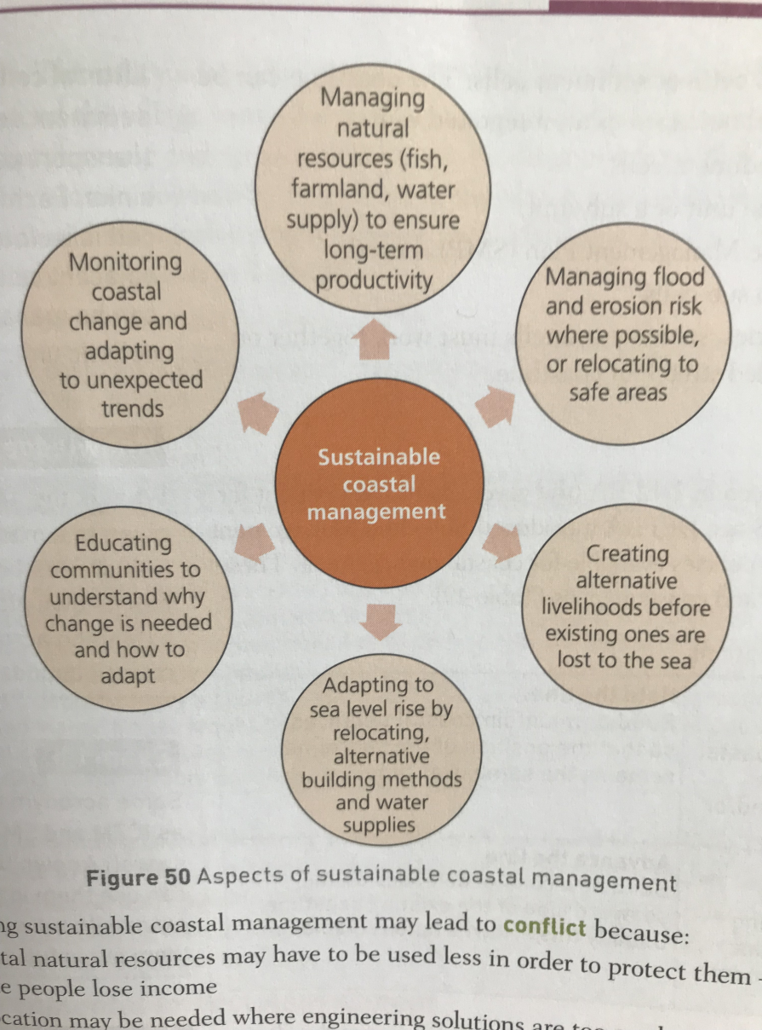
Sustainable coastal management – to adapt to rising sea levels and increasing numbers of storms as well as increased erosion and flooding, communities need to adopt sustainable coastal management.
Sustainable coastal management – Managing the wider coastal zone in terms of people and their economic livelihood, social and cultural wellbeing, safety from coastal hazards, as well as minimising environmental and ecological impacts.
Environmental Impact Assessment (EIA) aims to identify:
The short term impacts of construction on the coastal environment
The long term impacts of building new sea defences or changing policy from hold the line to do nothing
EIA includes assessments of:
Impacts on water movement and sediment flow
Impacts on water quality which can impact sensitive marine species
possible changes to flora and fauna including marine plants and species
Wider environmental impacts such as air quality and noise pollution during construction
Integrated coastal zone management (ICZM) | A holistic approach: The entire coast is managed up to 2km back from the shoreline. This includes: All ecosystems Resources Human activity It recognises the importance of the coastal zone to people’s livelihoods It recognises that management of the coast must be sustainable
DEFRA – oversee UK coastal management
Conflict winners and losers
Coastal management decisions directly affect people’s lives.
Winners – People who gain from a decision e.g. Economically (their property is safe), environmentally (habitats are conserved), socially (communities can remain in place
Losers – People who are likely to lose property, their business of jobs, be forced to move, see the coastline concreted over
Inevitability of winners and losers due to:
- DEFRA and councils have limited resoures
- SMPs mean some areas are protected and others not
There are 4 key approaches to managing the coastline DEFRA will consider in SMPs (shoreline management plans)
No intervention | No investment in defences against flooding or erosion, the coast is allowed to flood - ‘do nothing’.
Hold the line | Maintain the existing shoreline by building defences (this is the most common option – divided by hard and soft engineering techniques)
Strategic (Managed) realignment | Allow the coastline to move naturally (in most cases to recede), but managing the process to direct it in certain areas.
Advance the line | Build new coastal defences on the seaward side of the existing coastline. Usually involves land reclamation.
Sustainable coastal management may lead to conflict:
Coastal natural resources may have to be used less so some people lose income
Relocation may be needed
Some erosion/flooding will always occur – not everywhere can be protected
Future trends may mean management plans need changing creating uncertainty
Case study – Blackwater Estuary, Essex
Case study where all stakeholders agreed on management decision
New salt marshes were created by beaching the sea walls
Landowners were generously compensated
flood risk reduced as land allowed to flood to create the new ecosystems
Additional leisure and income streams from tourism
Coastal management in the developing world
Many areas in the developing world area experiencing rapid coastal erosion – Maldives, Vietnam, West African coast etc, often due to:
Upstream dams
Rapid and unplanned urbanisation, development of tourist resorts and piecemeal defences with no overall plan
Widespread destruction on mangrove forests
Many losers are the poorest, including farmers.
Cost benefit analsis:
CBA – used to help decide if defending a coastline from erosion and/or flooding is economically justifiable.
Happisburgh, North Norfolk
No active intervention decided based on CBA
To defend the village would have impacted on the wider coastal management plan
Too costly to defend the coast
Too much impact on erosion down the coast if hard engineering utilised

Slide 18
Coastal Landscapes and Change
Holderness Coast
Sediment Cell: Example of a sediment cell (11 around England & Wales).
Source = Flamborough Head’s chalk, transfer zones = long shore drift, sinks = depositional landforms e.g. Spurn Head.
Sediment cell is impacted by major erosion events e.g. during a storm or human intervention.
2. Coastal Management in a developed country - (policy decisions, stakeholders, winner / losers, attitudes, future uncertainty).
Hornsea and Mappleton: policy decision is to hold the line.
- HORNSEA: Regional economic centre, 8500 population, historic sites, Hornsea Mere (lake habitat for birds – SSSI)
MAPPLETON: protected since 1990’s – 2 rock groynes, rip-rap, cliff regrading (1991), if the decision was revisited it would be less likely to be defended. 2010 SMP – economic need for defending Mappleton was ‘marginal’.
In ‘no active intervention’ are 400m of land could be lost by 2105, B1242 will be lost by 2105, 200 hectares of farmland and 32 properties are likely to have been lost by 2055, the North Cliff are of Hornsea will have coastal properties at risk by 2055. High-possibility of coastal erosion outflanking its defences.
Examples of Coastal Landforms / features:
Folding – Northumberland Heritage Coast
Concordant - Lulworth Cove, Dorset
Discordant Coasts - West Cork, Ireland
Longest Fetch – Cornwall (4000km)
Stack – Old Man of Hoy is UK’s tallest (137m high)
Mass movement:
Rockfall: St Oswold’s Bay, Dorset (April 2013), 80-100m long section of cliff collapsed.
Rotational Slides: coastlines made of weak sedimentary rock or unconsolidated material – South Coast of England e.g. Folkestone or Holderness, East Yorkshire.
Post-glacial adjustment - Scotland is rebounding upward (1.5mm per year), England & Wales are subsiding (1mm per year).
Emergent coasts – Eastern Scottish coast near Fife.
Submergent coasts – Kingsbridge Estuary near Salcombe, Devon (ria).
Barrier Island - east coast of USA from Florida to Connecticut.

Slide 19
Coastal Landscapes and Change
Storm Surges:
The North Sea (2013): January 1953 = worst recorded, 2500 died (Netherlands), 325 people died from UK.
2013: conditions repeated themselves: very low air pressure (962 millibars), winds over 140mph, Gale-force northerly winds drove storm waves on the north-Sea coasts (5.8m recorded in Lincolnshire), corresponded with high tide → flooding.
Impacts: coastal flooding (Skegness), Scotland’s rail network shut down, 100,000 homes lost power, 2500 coastal homes & businesses were flooded, 15 deaths across Europe.
Although 2013 storm surge was higher in some places economic and social costs were lower (warnings, forecasts, defences).
Deltaweken (response): hard engineering mega project, Netherlands (1958-1997). US$5 billion. Rising sea-levels increases pressure on this. 2100 – 1.3m sea-level rise, US$1.5billion per year needs to be spent on sea defences.
2. Bangladesh (1970, 1991, 2007): tropical cyclones bring larger storm surges (lower pressure & stronger winds + intense rainfall).
Vulnerability: low-lying river delta (1-3m above sea level), incoming surges meet outflowing river discharge to combine river & coastal floods, unconsolidated delta sediment, deforestation.
Impacts: flooding, displacement of millions, crop failure – death tolls are decreasing due to improved warnings.
Cyclone Sidr: 3m storm surge, 260kmph winds, air pressure 944mb, 15,000 deaths, cost US$1.7billion
Erosion caused by dams: Aswan Dam, Nile Delta
Nile delta – depositional landform.
Since construction of the dam (1960’s) river discharge fell from 35 billion m3 to 10 billion per year. Sediment volume fell from 130 million tonnes to 15 million.
Why? Water withdrawals from the reservoir and sediment being trapped.
Effect: erosion rates in Rosetta increased from 20-25 m per year to over 200m.
- Highlights importance of river-transported sediment in maintaining the balance between erosion and deposition at the coast.
Islands at risk of coastal flooding & sustainable management: Maldives (Indian Ocean) & Tuvalu (Pacific)
Those most are risk = coral atolls (1-3m above sea level).
Maldives: 340,000 people, 1200 islands, highest point is 2.3m above sea level. 50cm seal level rise by 2100 = 77% of land area lost. Those remaining would be vulnerable to erosion and storm surges.
Male: capital city island, sustainable way to protect against erosion – 3m sea wall.
Hulhumale: artificial island created from dredged coral and sediment (1997-2002), US$32 million, 1 metre higher than Male.

Slide 20
Coastal Landscapes and Change
Coastal Management: developed country: The Blackwater Estuary, Essex
Area of tidal salt marsh and low-lying farmland, traditionally protected by flood embankments and revetments.
Responding to sea-level rise by building more / taller hard engineering defences is unsustainable due to coastal squeeze: estuary salt marshes migrate inland when sea levels rise, defences prevent this, removing natural protection.
60% of Essex marshes have eroded in past 10 years.
2000 – Essex Wildlife Trust purchased Abbots Hall Farm – 4000-hectare managed realignment scheme by breaching sea- wall in 2002 to allow for salt marshes to form.
Benefits: Abbots Hall Farm owners received a good price, high hold-the-line policy costs avoided, water quality improved, new paths / waterways created, income from eco-tourism / wildlife watching, bird habitats enhanced.
Consequences of flooding – East Riding Yorkshire.
High rates of erosion, threat to property. No national UK scheme to compensate for property loss, some limited help.
2010-2012: DEFRA provided £1.2 million to East Riding Council (one of 15 UK Coastal Change Pathfinder projects). Money was spent assisting 43 home owners with relocation and demolition expenses.
Coastal Change Fund: covers cost of property demolition and site restoration, offers £1000 relocation expenses, £200 hardship expenses.
Rollback policies – give people preferential treatment in finding new land and relax planning laws.
East Rising council expect 100 homes to be lost to the sea in next few decades.

Slide 21
Assess how coastal landscapes can be classified
Assess the importance of geological structures in developing coastal landscapes
Assess the importance of marine erosion in creating coastal landforms
Assess the importance of sediment transport and deposition in creating coastal landforms
Assess the extent to which rates of coastal recession and stability depend on lithology
Assess the importance of geology in creating a range of coastal landscapes.
Assess the relative importance of depositional processes along a name stretch of coast
Assess the importance of sediment transport and deposition in creating coastal landforms
Assess the importance of different processes in the development of cliff features
Assess the importance of lithology in coastal recession
Assess the significant of different weathering and mass movement processes in coastal landscape systems
Assess the importance of mass movement in influencing rates of coastal recession and landform change
Notes:
EQ1 & 2

Slide 22
Assess the influence of sea level on the coastal zone overtime.
Assess the important of eustatic changes to the UKs coastal landscape
Assess the threat of rapid coastal erosion to people
Assess the importance of human factors which have lead to rapid coastal erosion
Assess the risk of coastal flooding on the coast
Assess the significance of a countries level of development in determining the impact of coastal flooding
Assess the risk of coastal recession on communities
Assess the risk of coastal flooding on communities
Assess the value of coastal management in managed risk in the coastal zone
Assess the impact of coastal management along a stretch of coastline OR Assess the effectiveness of coastal management strategies along a stretch of coastline
Assess the effectiveness of hard engineering or soft engineering approaches designed to protect the coast from erosion
Assess the effectiveness of holistic coastal management strategies used to protect a stretch of coastline from erosion OR Assess the success of the policies which are designed to manage a coastline holistically
Notes:
EQ3 & 4

Slide 23
Coasts PPQs

Slide 24
Coasts- 12 markers
What does the word ‘assess’ mean?
Introduction: This should pick apart the question by defining and key words and putting the question in context (within the bigger picture of the topic). It only needs to be 2-4 sentences max.
The command words assess requires you to use evidence to determine the relative significance of something and to give balanced consideration to all factors and identify which are the most important. The exam board using a range of different question stems for the assess command word: assess the value; assess the extent; assess the importance; assess the significance.
Main Body: Each paragraph should have a structure and a clear purpose. All consider using a PEAL format for your paragraph:
• Point – one/ two sentences identifying what this paragraph is going to be able and how it links back to the question.
• Explain/example–You should also introduce any examples and case studies here.
• Assess – this should make up the bulk of you answer you should be critical all the way through. You should really think of this bit as an opinion line (see below) where does this point/factor fit on to that opinion line with evidence and a detailed and extended explanation to support this.
Think about answering these sorts of questions within this part of the paragraph. How important is this factor? Why? How does it compare to other factors? Have you got any evidence/examples to support this? How successful was this? Why? Phrases you might want to consider using are: this is important because, this in more important than… because, this is support by [evidence], this was successful at…because, however this is less important/ successful than… because….
• Link – briefly sum up your paragraph and link you ideas back to the question.
Conclusion: Your conclusion is also a chance to assess but consider a range of factors rather than just one like your paragraphs. It also gives you a chance to directly link all your ideas back to the question. You shouldn’t be introducing any new facts or evidence here but should consider which is the most significant/ importance/ successful. It might be easier to think of this bit like an Olympic podium which are your gold, silver and bronze factors and how to they compare in terms of significance.

Slide 25
EQ1 - Why are coastal zone different and what processes cause these differences?
The coast, and wider littoral zone, has distinctive features and landscapes
Assess how coastal landscapes can be classified
Assess the importance of geology in creating a range of coastal landscapes.
Geological structure influences the development of coastal landscapes at a variety of scales
Assess the importance of geological structures in developing coastal landscapes
Rates of coastal recession and stability depend on lithology and other factors
Assess the importance of lithology in coastal recession
Assess the extent to which rates of coastal recession and stability depend on lithology
EQ2 - How do characteristic coastal landforms contribute to coastal landscapes?
Marine erosion creates distinctive coastal landforms and contributes to coastal landscapes
Assess the importance of marine erosion in creating coastal landforms
Assess the importance of different processes in the development of cliff features
Sediment transport and deposition create distinctive coastal landforms and contribute to coastal landscapes
Assess the importance of sediment transport and deposition in creating coastal landforms
Assess the relative importance of depositional processes along a name stretch of coast
Sub-aerial processes influence coastal landforms and contribute to coastal landscapes
Assess the importance of sediment transport and deposition in creating coastal landforms
Assess the significant of different weathering and mass movement processes in coastal landscape systems
Assess the importance of mass movement in influencing rates of coastal recession and landform change

Slide 26
EQ3 - How do coastal erosion and sea level change alter the physical characteristics of coastlines and increase risk?
Sea level change influences coasts on different timescales
Assess the influence of sea level on the coastal zone overtime.
Assess the important of eustatic changes to the UKs coastal landscape
Rapid coastal retreat causes threats to people at the coast
Assess the threat of rapid coastal erosion to people
Assess the importance of human factors which have lead to rapid coastal erosion
Coastal flooding is a significant and increasing risk for some coastlines
Assess the risk of coastal flooding on the coast
Assess the significance of a countries level of development in determining the impact of coastal flooding
EQ4- How can coastlines be managed to meet the needs of all players?
Increasing risks of coastal recession and coastal flooding have serious consequences for affected communities
Assess the risk of coastal recession on communities
Assess the risk of coastal flooding on communities
Different approaches to managing the risks associated with coastal recession and flooding
Assess the value of coastal management in managed risk in the coastal zone
Assess the impact of coastal management along a stretch of coastline
Assess the effectiveness of hard engineering approaches designed to protect the coast from erosion
Assess the effectiveness of soft engineering approaches designed to protect the coast from erosion
Assess the effectiveness of coastal management strategies along a stretch of coastline
Coastlines are increasingly managed by holistic integrated coastal zone management (ICZM)
Assess the effectiveness of holistic coastal management strategies used to protect a stretch of coastline from erosion
Assess the success of the policies which are designed to manage a coastline holistically

Slide 27
Coasts- 12 markers
What does the word ‘assess’ mean?
Introduction: This should pick apart the question by defining and key words and putting the question in context (within the bigger picture of the topic). It only needs to be 2-4 sentences max.
The command words assess requires you to use evidence to determine the relative significance of something and to give balanced consideration to all factors and identify which are the most important. The exam board using a range of different question stems for the assess command word: assess the value; assess the extent; assess the importance; assess the significance.
Main Body: Each paragraph should have a structure and a clear purpose. All consider using a PEAL format for your paragraph:
• Point – one/ two sentences identifying what this paragraph is going to be able and how it links back to the question.
• Explain/example–You should also introduce any examples and case studies here.
• Assess – this should make up the bulk of you answer you should be critical all the way through. You should really think of this bit as an opinion line (see below) where does this point/factor fit on to that opinion line with evidence and a detailed and extended explanation to support this.
Think about answering these sorts of questions within this part of the paragraph. How important is this factor? Why? How does it compare to other factors? Have you got any evidence/examples to support this? How successful was this? Why? Phrases you might want to consider using are: this is important because, this in more important than… because, this is support by [evidence], this was successful at…because, however this is less important/ successful than… because….
• Link – briefly sum up your paragraph and link you ideas back to the question.
Conclusion: Your conclusion is also a chance to assess but consider a range of factors rather than just one like your paragraphs. It also gives you a chance to directly link all your ideas back to the question. You shouldn’t be introducing any new facts or evidence here but should consider which is the most significant/ importance/ successful. It might be easier to think of this bit like an Olympic podium which are your gold, silver and bronze factors and how to they compare in terms of significance.

Slide 28
Water Revision Activities & Notes

Slide 29
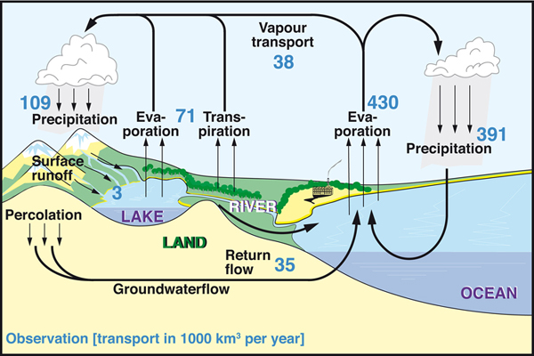
The water cycle and insecurity – EQ1:What are the processes operating within the hydrological cycle from global to local scale?
Exam Hint – Sometimes flows are referred to as transfers. Be sure t know the differences between the four flows.
Key words
Surface runoff
Groundwater
Fossil water
Cryosphere
Blue / Green water
Residence time
Key themes
The global hydrological cycle
The drainage basin
The water budget & river systems
FLOWS are the transfers of water from one store to another. There are four main flows; precipitation, evaporation, transpiration, vapour transport.
FLUXES are the rates of flow between stores. The greatest fluxes occur over the oceans.
Global hydrological cycle
CLOSED SYSTEM of linked processes.
No external inputs or outputs.
Finite and constant amount of global water.
CHANGE: the state that water exists.
Solar (heat) & gravitational (downhill flow) energy power the cycle.
STORES – ‘reservoirs’ where water is held. Four main stores are
Oceans - largest
Glaciers & ice sheets = CRYOSPHERE – 2nd largest (69% of fresh water).
Surface runoff – rivers, lakes & groundwater flow (30%)
The atmosphere
Notes:
http://www.alevelgeography.com/drainage-basin-hydrological-system/ - info / clips

Slide 30
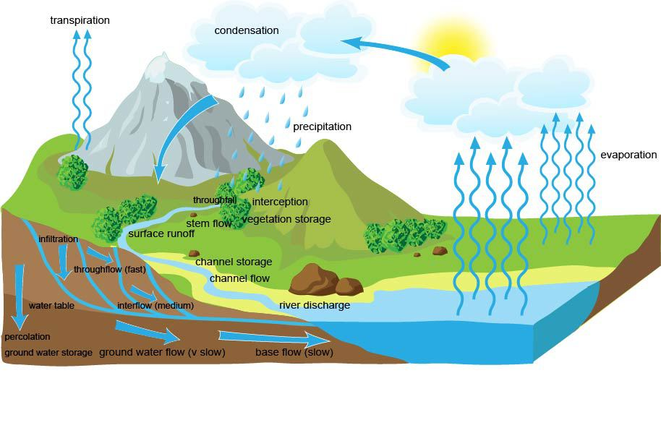
The water cycle and insecurity – EQ1:What are the processes operating within the hydrological cycle from global to local scale?
Drainage Basin
Subsystem of global hydrological cycle.
Open system – external inputs and outputs that vary over time, therefore the amount of water in the drainage basin varies.
Vary in size from small local streams to huge rivers, e.g. the Amazon.
Human / physical factors impact drainage basin systems.
Inputs | Flows | Outputs
PRECIPITATION can vary in many ways, these impact the drainage basin cycle; Form – snow, hail, rain. Amount Intensity Seasonality Distribution | Interception – plants retain leading to evaporation. Infiltration – soaks into soil. Percolation – soaks into permeable rocks. Throughflow – lateral transfer of water downslope. Groundwater Flow – slow, percolated water through porous rock. Surface runoff – Movement of water across the ground, not confined to river channel. River or channel flow – flow is confined to the channel. | Evaporation - lost directly to the atmosphere Transpiration – biological process, lost from plants to the atmosphere. Discharge – lost into another larger drainage basin, lake or the sea.
Exam Hint – It is important to know the seven flows, their features and courses.
Notes:
http://www.alevelgeography.com/drainage-basin-hydrological-system/ - info / clips

Slide 31
The water cycle and insecurity – EQ1:What are the processes operating within the hydrological cycle from global to local scale?
Drainage Basin
Subsystem of global hydrological cycle.
Open system – external inputs and outputs that vary over time, therefore the amount of water in the drainage basin varies.
Vary in size from small local streams to huge rivers, e.g. the Amazon.
Inputs | Flows | Outputs
PRECIPITATION can vary in many ways, these impact the drainage basin cycle; Form – snow, hail, rain. Amount Intensity Seasonality Distribution | Interception Infiltration Percolation Throughflow Groundwater Flow Surface runoff River or channel flow | Evaporation - lost directly to the atmosphere Transpiration – biological process, lost from plants to the atmosphere. Discharge – lost into another larger drainage basin, lake or the sea.
Impact of physical features:
Climate
Soils
Geology
Vegetation
Exam Hint – It is important to know the seven flows, their features and courses.
Impact of human features:
River management
Deforestation
Changing land use – agriculture
Changing land use - urbanisation
Notes:
http://www.alevelgeography.com/drainage-basin-hydrological-system/ - info / clips

Slide 32
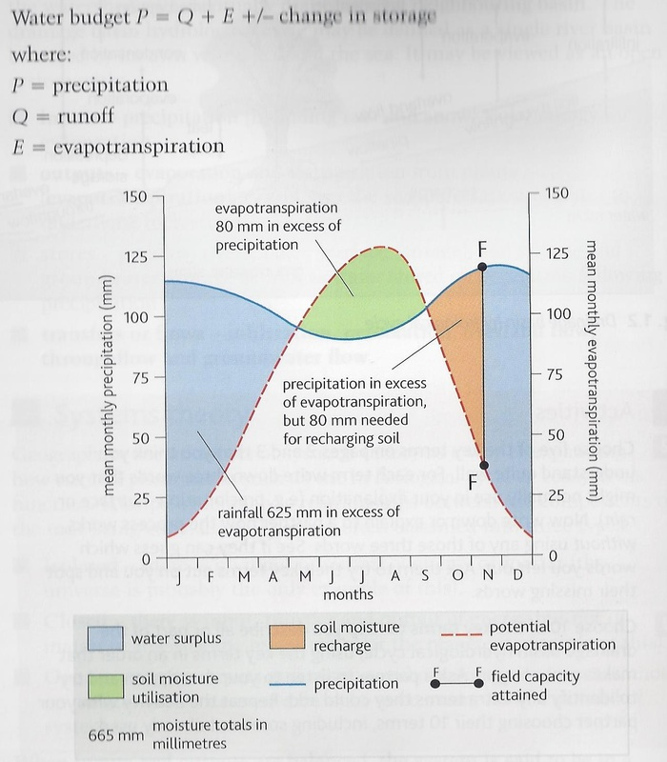
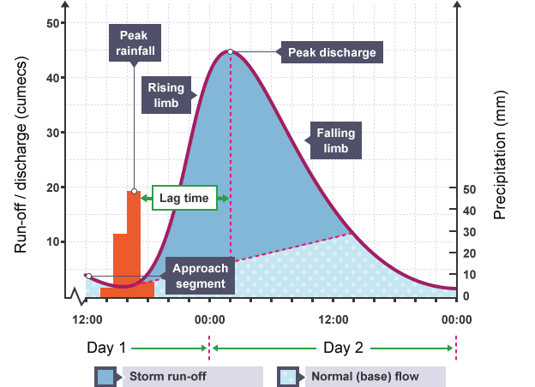
The water cycle and insecurity – EQ1:What are the processes operating within the hydrological cycle from global to local scale?
Water budgets & River Systems
Annual balance between precipitation, evapotranspiration and runoff.
Water budgets can be calculated at a global to local scale and give a useful indication of the amount of water for human use (Available soil water).
River regime is the annual variation in the discharge or flow of a river.
‘flashy’ v’s flat river
Exam Hint – Ensure you can explain the ways in which urbanisation affects hydrological processes and the factors that affect the shape of a hydrograph (e.g. weather, rock type, soils, relief, shape, vegetation, antecedent conditions.).

Slide 33
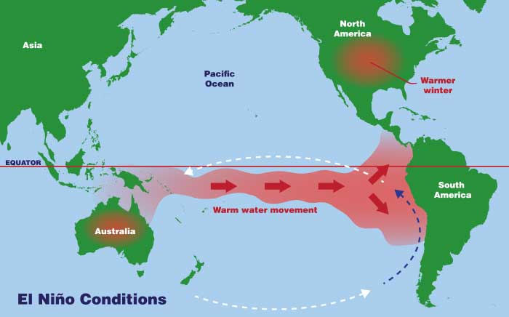
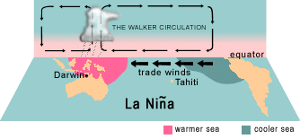
The water cycle and insecurity – EQ2: What factors influence the hydrological system over short and long term timescales?
Exam Hint –You will be expected to know the difference between El Nino & La Nina and how each contributes to drought. You do not need to know the detailed mechanics of them!
Key themes
Short term deficits = drought
Short term surplus = flooding
Longer term climate change can have global and local impacts.
Meteorological drought - is a shortfall or deficiency of water over an extended period of time, usually at least a season. Hydrological drought – reduced stream flow, lowered groundwater levels and reduced stores.
Causes are physical but human activity can make the impacts worse.
Sea surface temperature anomalies are an important factor in short-term precipitation deficits.
EL NINO – Southern Oscillation (ENSO)
Temperature anomalies are the key to ENSO, which leads to droughts.
Normal conditions in the Pacific Basin – trade winds blow east to west long the equator.
El Nino conditions – Trade winds are disrupted and can slaken or reverse, this has a knock on effect on ocean currents meaning cool water normally found along the coast of Peru is replaced by warmer water. At the same time the warm water further west off the coast of Australia is replaced by cool water. These events occur every 3 – 7 years and usually last for 18 months. They trigger dry conditions throughout the world e.g. monsoon rains in India & SE Asia often fail.
La Nina conditions – may, but not always follow an El Nino event. They involve the build up of cooler than usual subsurface water in the tropical part of the Pacific. This situation can also lead to severe drought conditions, particularly on the western coast of South America.
Notes:
ENSO clip - https://www.metoffice.gov.uk/research/climate/seasonal-to-decadal/gpc-outlooks/el-nino-la-nina/enso-description (4mins)

Slide 34
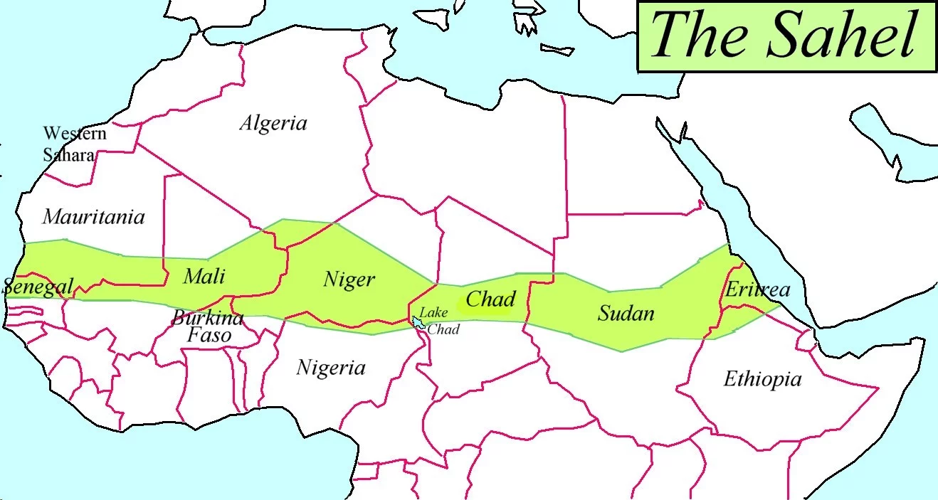
The water cycle and insecurity – EQ2: What factors influence the hydrological system over short and long term timescales?
Exam Hint – The Sahel is the classic example of desertification. Be sure you are fully aware of the human contributions to the process.
Human Activity and drought risk
Desertification in the Sahel region of Africa is mainly due to natural causes:
Changing rainfall patterns, less reliable rains seasonally and annually.
Vegetation cover is stressed and begins to die, leaving bare soil.
Exposed soil is eroded by winds and occasional intense showers.
When rain falls it is often for intense, short periods meaning the soil cannot capture or store it.
Human factors enhance the impacts of droughts by over-abstraction of surface water (rivers / ponds) and ground water (aquifers). This is driven by:
Population growth
Overgrazing
Overcultivation
Deforestation
Ecological impact of drought
- Ecological resilience is crucial – the capacity of an ecosystem to withstand and recover from a natural event or some form of human disturbance.
- Ensure you can explain how the resilience of forests & wetlands is impacted by drought.
Drought in Australia - annual feature with 30% of the country affected by serious or severe rainfall deficiency.
Close link to El Nino events, however droughts are becoming more frequent & severe.
BIG DRY 2006 – 1 in 1000 year event associated with longer term climate change. Although a severe drought occurred it did not follow the same downward spiral of desertification as seen in the Sahel. Why?
Management of scarce resource to sort the competing demands of irrigation & urban dwellers, large scale recycling of grey water, desalination plants and conservation strategies.
Notes:
http://www.alevelgeography.com/drainage-basin-hydrological-system/ - info / clips

Slide 35
The water cycle and insecurity – EQ2: What factors influence the hydrological system over short and long term timescales?
Exam Hint – Have some key facts about a flood event ready. They will add conviction to your answers.
Surpluses within the hydrological cycle generally mean flooding.
Intense storms = flash floods.
Prolonged heavy rain.
Rapid snowmelt during warm Spring seasons.
Impacts of flooding
Socioeconomic – death, injury, water-borne diseases, damage to property (housing), disruption to transport / communication, destruction of crops / livestock.
Environmental – receive much less publicity. Removal of soil and sediment by floodwater can lead to eutrophication (nutrient enrichment – leading to less oxygen → death of fish etc). Also pollutants can be leached into water courses. ☺ recharged ground water stores, soil replenishment and triggering of breeding events for some species.
Physical causes | Human causes
- Relief, nature of the land, climate, impermeable surfaces, volcanic activity generating meltwater, earthquakes leading to dam failures or river blocks. E.g. Bangladesh is made up of floodplains & deltas of large rivers swollen twice a year by melt waters of Himilayas and the summer monsoon. Storm surges lead to tidal flooding. | Land-use change driven by economic & population growth. E.g. building on floodplains, removal of natural landscapes for agriculture, industry or urbanisation. - River Management. E.g. channelization, dams & embankments.
UK FLOODS 2007, 2013 & 2016
2016 – UK received more than twice the average amount of rainfall. Carlisle and Cockermouth in Cumbria were among the worst hit places.
Things to blame were: budget cuts, EU Directive that puts environmental conservation ahead of regular dredging of rivers, poor land management, global warming.
Exam Hint – Remember not all impacts are negative.
Notes:
http://www.alevelgeography.com/drainage-basin-hydrological-system/ - info / clips

Slide 36
The water cycle and insecurity – EQ2: What factors influence the hydrological system over short and long term timescales?
Group Task: 5 mins
Work together to summarise the potential impacts of climate change on the hydrological cycle.
Inputs & Outputs
Precipitation
Evaporation & Transpiration
Soil moisture
Flows & Stores
Surface runoff & stream flow
Groundwater flow
Reservoir, lake and wetland storage
Soil Moisture
Permafrost
Snow
Glacier Ice
Oceans
Impacts of climate change on the hydrological cycle
Challenge: How does this topic relate to paper 3 – SYNOPTIC THEMES?
We live in an uncertain world. Here the uncertainty arises because even modern scientific research in unable to make confident forecasts about the future availability of water. But even if scientists were able to do this, there are other important unknowns to be taken into account, such as possible advances in water technology and factors related to the demand side, such as population growth and the rising tide of global development.

Slide 37
The water cycle and insecurity – EQ2: What factors influence the hydrological system over short and long term timescales?
Group Task: 5 mins
Work together to summarise the potential impacts of climate change on the hydrological cycle.
Impacts of climate change on stores and flows
Impacts of climate change on inputs and outputs

Slide 38
The water cycle and insecurity – EQ3: How does water insecurity occur and why is it becoming such a global issue for the 21st Century?
Rising Water Demand - Population growth, economic development, rising living standards.
- In addition to the rising demand there is increasing competition between users.
Key themes
Water insecurity is a concern for many countries and is the outcome of both physical and human factors.
Bring both serious consequences and risks.
Growing need for sustainable management of water supplies.
Causes of water insecurity
Accessible surface water is a scare resource.
Increasing pressure – population growth & economic development.
Mismatch in distribution of fresh water and demand for water.
Water Insecurity: available water is less then 1700mᵌ per person per year. This marks the start of water stress. Below 1000mᵌ gives way to water scarcity.
Consequences
Physical Scarcity | Economic Scarcity
75% of a country / regions blue water flows are being used. 25% of world’s population. E.g. Middle East, Western USA. | Blue water sources is limited by lack of capital, technology and good governance. 1 billion people are restricted by poverty, most live in African countries.
Water Availability – conditioned by climate.
The availability of water for human use is affected by a range of human and physical factors. E.g. evaporation, discharge into the sea, contamination, over-abstraction.
Synoptic Themes: Where in the world are in imminent danger of becoming victims of water scarcity? Who should identify this? How confident can we be that projections are accurate and reliable?

Slide 39
The water cycle and insecurity – EQ3: How does water insecurity occur and why is it becoming such a global issue for the 21st Century?
Safe Water (fit for human consumption).
- Is this a human right or a commodity for which a realistic price should be paid?
Mush of water supply industry is run by private companies.
Charities such as WaterAid also play a significant role in developing countries.
Water supply and economic development
Agriculture – 20% of world’s land is under full irrigation. 30% of that comes from dams and their irrigation canals. Majority is pumped from aquifers leading to groundwater depletion (China, USA).
Industry and energy – 20% of freshwater use is for industry (chemicals, electronics) and energy production. Pollution is a major problem associated with this. Half of water used for energy is for HEP / cooling, this does not causes major concern. Growth of biofuels is increasing demand for water.
Domestic use – Improving living standards = increased water consumption. Safe water is vital for human health, poor sanitation / polluted water is having debilitating effects of human health. E.g diseases such as typhoid, cholera and providing a breeding ground for disease vectors carrying things such as malaria.

Slide 40
The water cycle and insecurity – EQ3: How does water insecurity occur and why is it becoming such a global issue for the 21st Century?
Approaches to managing water supply –due to the large number of players involved there are conflicting views about the best way to manage supplies.
Hard-engineering | Sustainable management
Water Transfers – diversion of water from one basin to another (area of surplus to an area of deficit). E.g. China’s South – North transfer project. Mega dams – 60% of the worlds rivers are impeded by large dams. These require large amount of capital and cause issues such as high evaporation losses, transport of sediment downstream and displacement of people. Desalination – technological advances allows this to be used on a wider scale, however it is expensive and requires a lot of energy. | AIMS – minimise wastage, pollution, ensure access to safe water for all, take into account views of all users, equitable distribution of water within and between countries. Smart irrigation Hydroponics – growing crops in greenhouses without soil (drip-fed nutrients and water). Rainwater harvesting Filtration technology Restoration of damaged rivers, lakes and wetlands.
Potential Conflicts - Within countries ‘water wars’ occur between competing demands e.g. irrigation, energy, domestic use, energy. Trans-boundary water sources can see a raised competition and lead to international tensions and conflict.
CASE STUDY – The Nile
-6700km – longest river in the world.
11 countries compete for its water.
300 million people live within the Nile basin – rate of population growth is rapid. It’s set to double by 2030.
Key uses = domestic consumption, growing crops and HEP generation.
Flash points = damns in Sudan and Ethiopia restricting flow downstream in Egypt.
Synoptic Themes: Conflicts can occur at any scale from local to international.
Local - key players are water users (farmers, industrialists, households). Their views differ from other players such as planners, environmentalists and water providers.
Internationally - key players include governments and users of trans-boundary water sources and in some cases organisations like the UN.

Slide 41
The water cycle and insecurity – EQ3: How does water insecurity occur and why is it becoming such a global issue for the 21st Century?
Integrated Drainage Basin Management (IWRM) – first advocated in late 1990’s. Emphasises the river basin as a logical geographical unit for the management of water resources. Based on achieving a close cooperation between users and players with a holistic approach to ensure:
Environmental quality
Water is used with maximum efficiency
Equitable distribution among users
IWRM tends to work well at a community level, but not so well in larger basins, especially if an international boundary is involved.
Water sharing treaties and frameworks:
Helsinki Rules – equitable use and shares concepts
United Nations Economic Commission for Europe (UNECE) Water Convention – joint management and conservation of shared freshwater ecosystems.
UN Water Courses Convention – guidelines for use and protection of transboundary rivers.
EU Water Framework Directive (2000) – committing all members to ensure ‘status’ of their water bodies, including marine waters up to 1 nautical mile from shore.
CASE STUDY – SINGAPORE
- Few natural water resources, thriving economy, high SoL & per capita water consumption.
Adopted a holistic approach to water management:
Collect every drop – since 2003 per capita domestic consumption has fallen from 165L to 150L per day.
Re-use water – cutting edge technology for grey water.
Desalinate more seawater – two desalination plants now meet 25% of demand.
- Despite this Singapore still has to import water from Malaysia.
Synoptic Themes: Attitudes to water usage and supply vary. Some see clean water as a human right, others as a need. Some businesses secure their water regardless of the costs and environmentalists insist provision must be sustainable. This can lead to tensions and conflicts at both local and international scales between a variety of players.

Slide 42
What are the processes operating within the hydrological cycle?
The importance of the global hydrological cycle
1. What is meant by a store and a flow? (2)
A store is where water is held for varying amounts of ‘residence’ time. A flow is the movement of water between stores.
2. Identify the THREE largest stores in size of order? (3)
The oceans, icecaps and glaciers, and groundwater.
3. Which TWO water stores are non-renewable, and why? (4)
Fossil water: old, deep groundwater from former wetter periods. Losses from the cryosphere: melting of ice as a result of global warming.
4. Distinguish between blue water and green water (3)
Blue water is stored in rivers, lakes and groundwater in liquid form — a visible part of the hydrological cycle. Green water is water stored in the soil and vegetation — an invisible part of the hydrological cycle.
5. Why is the global hydrological cycle a closed system? (4)
There are no external inputs and outputs. It is a self-contained entity. Some might argue solar energy, which drives the cycle, is an input.
6. What is the water budget, and why does it vary from place to place? (6)
The water budget of a place is the difference between the amount of water gained from precipitation and the amount lost as a result of evapotranspiration. The budget is in surplus when precipitation exceeds evapotranspiration. It is in deficit when the situation is reversed. It varies from place to place because climate (precipitation and temperature) does.

Slide 43
What are the processes operating within the hydrological cycle?
The drainage basin system
7. What are the main inputs of a drainage basin system? (2)
Precipitation. Also possibly water from a tributary basin.
8. What are the main outputs of the drainage basin system? (2)
Evaporation, transpiration and river discharge.
9. How does relief affect the inputs and outputs of a drainage basin? (4)
Altitude will affect the precipitation input (orographic rain or snow). The steepness of slopes will affect the rate of runoff — the steeper the slope, the faster the rate.
10. Distinguish between interception and infiltration (3).
Interception is the process by which water is stored in the vegetation. Infiltration is the process by which water soaks into, or is absorbed by the soil.
11. How does geology affect the flows in a drainage basin? (4)
Geology affects the balance of the flows by which precipitation reaches a river. Where the geology is hard and impermeable (e.g. granite), there will be much surface runoff and relatively little infiltration and percolation. Where rock is porous, then the balance will be the reverse with little runoff and much percolation and water reaching the river via through flow and groundwater flow.
12. Describe how deforestation is affecting the Amazon basin (6).
The amount of water returning to the atmosphere by evapotranspiration is greatly reduced — from 75% to 25% of intercepted water. More precipitation enters the river by runoff. Overland flow increases the amount of soil erosion. Huge quantities of soil are entering the rivers and causing extensive silting. Mudslides are increasing in frequency and scale. The flood risk is raised by the faster runoff. Aquifers are becoming depleted because less water infiltrates to recharge them.
13. Name THREE other ways in which people disrupt the drainage basin cycle (3).
Urban growth; constructing dams and reservoirs; abstracting water for irrigation.

Slide 44
What are the processes operating within the hydrological cycle? Water budgets and river systems
14. Distinguish between a water budget and a river regime (3).
Water budget is the difference between precipitation and evapotranspiration, which varies from place to place and seasonally. River regime is the seasonal variation in the discharge or flow of a river and it too varies, but from drainage basin to drainage basin.
15. How does climate affect water budgets? (3)
It affects the amount of precipitation received, while temperatures affect rates of evaporation and transpiration.
16. Identify THREE physical factors affecting a river’s regime (3).
Amount and intensity of precipitation; geology and soils; vegetation cover.
17. Study Figure 1 which shows runoff in the drainage basins of three rivers in Western Europe. How do you explain the seasonal variations in runoff when rainfall is evenly distributed throughout the year? (4).
Runoff in the drainage The lower runoff during the summer and early autumn is due to the higher temperatures and high water losses due to evapotranspiration. Also the dry ground means that much of the rain infiltrates and percolates below ground.
18. What is a storm hydrograph? (3)
A storm hydrograph shows the response of a river’s discharge following a period of rainfall. A critical aspect of the hydrograph is the lag time between the rainfall peak and the river’s peak discharge.
19. How does geology affect the shape of a storm hydrograph? (4)
If the geology is hard and impervious, then the speed of runoff will be such as to result in a relatively short lag time. If the geology is soft and porous, then runoff will be less and the water will reach the river more slowly as it takes place below ground. The lag time will be relatively long.
20. Why does urbanisation increase the risk of flooding (6)?
The large areas of concrete and tarmac mean that most falling rain becomes surface runoff which moves quickly to the nearest stream or river. Underground drains and sewers also move water quickly to drainage channels. Because of this swift transfer of water, rivers quickly reach the bank-full stage and water begins to overspill their channels as floods.

Slide 45
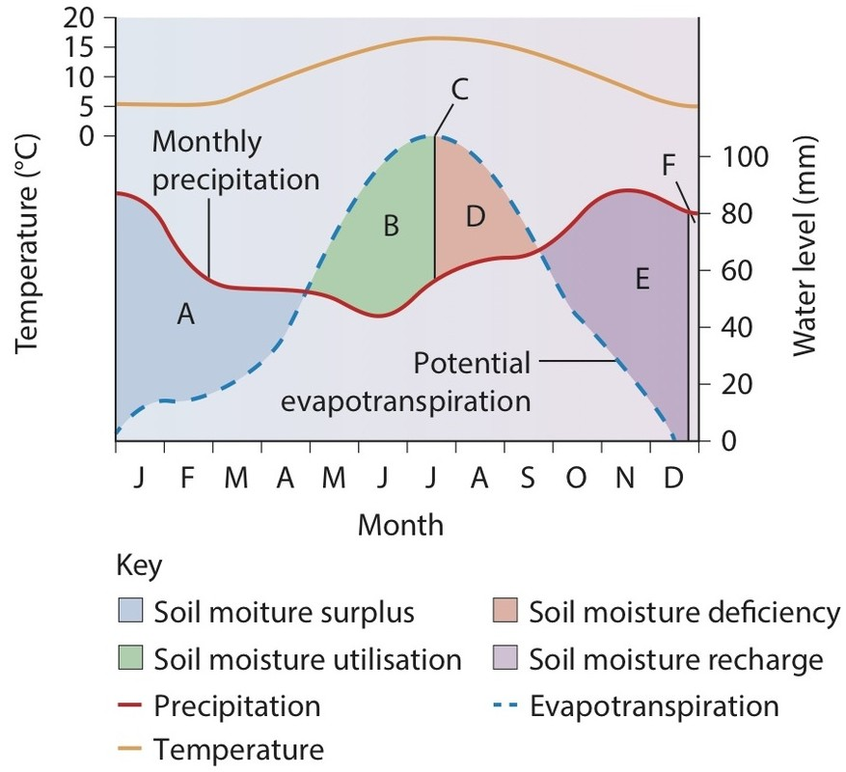
The water cycle and insecurity - REVISION
Key words
Surface runoff
Groundwater
Fossil water
Cryosphere
Blue / Green water
Residence time
EQ1:What are the processes operating within the hydrological cycle from global to local scale?
EQ2: What factors influence the hydrological system over short and long term timescales?
EQ3: How does water insecurity occur and why is it becoming such a global issue for the 21st Century?
1 a) Study Figure 1. Explain why there is a change from soil moisture surplus to soil moisture deficiency as you move from A to D. (3 marks)
b) Explain how physical factors in a drainage basin affect inputs, flows and outputs. (6 marks)
c) Explain how drought is affected by physical and human factors. (8 marks)
Notes:
http://www.alevelgeography.com/drainage-basin-hydrological-system/ - info / clips

Slide 46
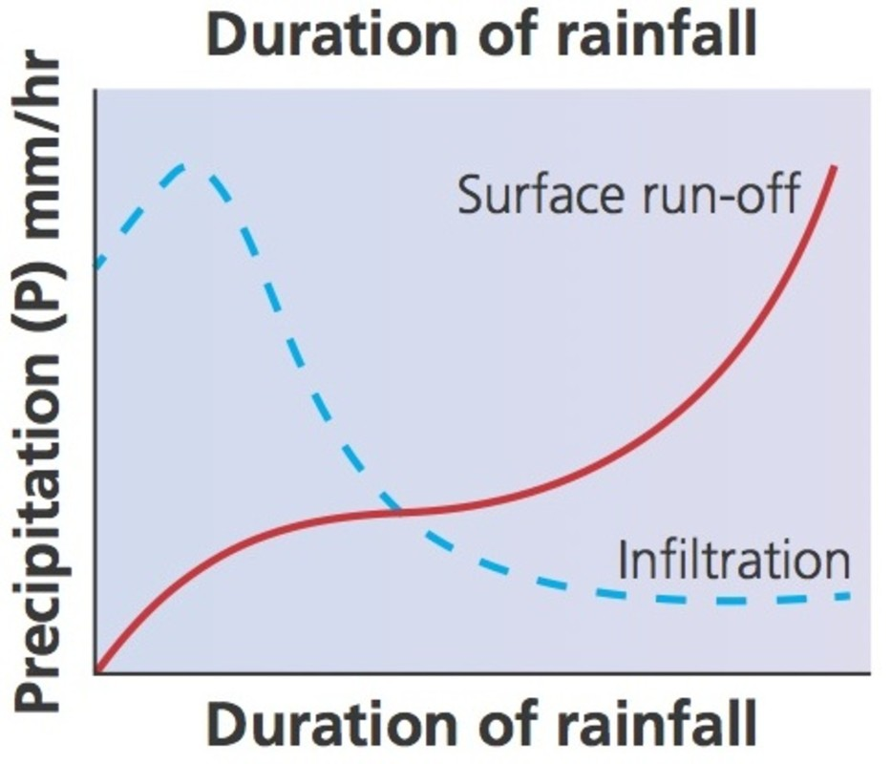
The water cycle and insecurity - REVISION
Key words
Surface runoff
Groundwater
Fossil water
Cryosphere
Blue / Green water
Residence time
EQ1:What are the processes operating within the hydrological cycle from global to local scale?
EQ2: What factors influence the hydrological system over short and long term timescales?
EQ3: How does water insecurity occur and why is it becoming such a global issue for the 21st Century?
TASK: Work in pairs to plan the answers to question 1 below.
Use the mark scheme to add to / improve your plan.
Write the answers to each of the questions.
2 a) Study Figure 1. Analyse the changes in infiltration and surface run-off over time shown on the graph. (3 marks)
b) Explain the physical and human factors that influence the response of a storm hydrograph to a rainstorm. (6 marks)
c) Explain the physical and human factors that can cause flooding. (8 marks)
Notes:
http://www.alevelgeography.com/drainage-basin-hydrological-system/ - info / clips

Slide 47
The water cycle and insecurity - REVISION
EQ1:What are the processes operating within the hydrological cycle from global to local scale?
EQ2: What factors influence the hydrological system over short and long term timescales?
EQ3: How does water insecurity occur and why is it becoming such a global issue for the 21st Century?
Explain why river regimes might vary between basins. (6)
Explain how physical and human factors contribute to an increased risk of water insecurity. (8)
Explain how climate change might have significant impacts on the operation of the water cycle. (8)
Explain how the global hydrological cycle operates as a closed system. (6)
Explain why a drainage basin can be regarded as an open system. (6)
Explain the meteorological causes of river flooding. (8)
Notes:
http://www.alevelgeography.com/drainage-basin-hydrological-system/ - info / clips

Slide 48
The water cycle and insecurity – PEQ’s
Assess the extent to which some approaches to future water supply management are more sustainable than others. (12)
Using examples assess the extent to which the hydrological cycle can influence river systems at a local level. (12)
Using examples assess ways in which deficits within the hydrological system can have significant impacts. (12)
Using examples assess the extent to which human activities can exacerbate flood risk. (12)
Using examples assess the impacts that climate change may have on the hydrological cycle. (12)
Assess the risks associated with water insecurity. (12)
Assess the effectiveness of strategies designed to make water use more sustainable. (12)
Assess the significance of environmental and economic impacts caused by river floods. (12)
Notes:
http://www.alevelgeography.com/drainage-basin-hydrological-system/ - info / clips

Slide 49
The water cycle and insecurity – PEQ’s
TASK: Read the question, for a 20 mark essay we are aiming for at least 3-4 PEE/AL paragraphs, each discussing a different factor / example / point in detail.
- Discuss what information could be include in your answers.
Evaluate the contribution of large-scale schemes to increasing water security. (20)
INTODUCTION:
What is water insecurity? How is it measured?
What methods can be used to combat it?
Signpost!
Water Transfers – diversion of water from one basin to another (area of surplus to an area of deficit). E.g. China’s South – North transfer project.
Mega dams – 60% of the worlds rivers are impeded by large dams. These require large amount of capital and cause issues such as high evaporation losses, transport of sediment downstream and displacement of people.
OR smaller scale / sustainable approaches. E.g smart irrigation, rainwater harvesting, filtration technology.
CONCLUSION:
- Show an overall evaluation → which has the greatest contribution, why?
FOCUS in clearly linking each one to increasing water insecurity.
Evaluate the view that some approaches to managing water insecurity are more sustainable than others. (20)
INTODUCTION:
What is water insecurity? What methods can be used to combat it?
How can the sustainability of these be measured?
Signpost!
Water Transfers – diversion of water from one basin to another (area of surplus to an area of deficit). E.g. China’s South – North transfer project.
Mega dams – 60% of the worlds rivers are impeded by large dams. These require large amount of capital and cause issues such as high evaporation losses, transport of sediment downstream and displacement of people.
Desalination – technological advances allows this to be used on a wider scale, however it is expensive and requires a lot of energy.
SUSTAINABLE - AIMS – minimise wastage, pollution, ensure access to safe water for all, take into account views of all users, equitable distribution of water within and between countries.
Smart irrigation
Hydroponics – growing crops in greenhouses without soil (drip-fed nutrients and water).
Rainwater harvesting
Filtration technology
Restoration of damaged rivers, lakes and wetlands.
FOCUS:
How can you weigh up the sustainability of each one?
CONCLUSION:
- Show an overall evaluation → which is the most sustainable, why?
Notes:
http://www.alevelgeography.com/drainage-basin-hydrological-system/ - info / clips

Slide 50
The water cycle and insecurity – PEQ’s
TASK: Read the question, for a 20 mark essay we are aiming for at least 3-4 PEE/AL paragraphs, each discussing a different factor / example / point in detail.
- Discuss what information could be include in your answers.
Evaluate the extent to which water insecurity is the result of physical or human cause. (20)
INTRODUCTION:
What is water insecurity?
Causes of drought are physical but human activity can make the impacts worse. How does this link to insecurity?
CONCLUSION:
Ensure you provide a clear evaluation of the overall extent to which human / physical causes are responsible for insecurity.
Diminishing supply - Accessible surface water is a scare resource. Increasing pressure – population growth & economic development. Mismatch in distribution of fresh water and demand for water.
- Water Availability – conditioned by climate.
The availability of water for human use is affected by a range of human and physical factors. E.g. evaporation, discharge into the sea, contamination, over-abstraction.
Rising Water Demand / competing demands - Population growth, economic development, rising living standards.
- Increasing competition between users both within and between basins.
Notes:
http://www.alevelgeography.com/drainage-basin-hydrological-system/ - info / clips

Slide 51
The Water Cycle and Security
EL NINO – Southern Oscillation (ENSO)
Temperature anomalies are the key to ENSO, which leads to droughts.
Normal conditions in the Pacific Basin – trade winds blow east to west long the equator.
El Nino conditions – Trade winds are disrupted and can slaken or reverse, this has a knock on effect on ocean currents meaning cool water normally found along the coast of Peru is replaced by warmer water. At the same time the warm water further west off the coast of Australia is replaced by cool water. These events occur every 3 – 7 years and usually last for 18 months. They trigger dry conditions throughout the world e.g. monsoon rains in India & SE Asia often fail.
La Nina conditions – may, but not always follow an El Nino event. They involve the build up of cooler than usual subsurface water in the tropical part of the Pacific. This situation can also lead to severe drought conditions, particularly on the western coast of South America.
Deforestation: The Amazon (immense environmental impacts due to the scale).
Amazon contains 60% of world’s rainforest – huge significance as a life support system.
“lungs of the earth” – carbon sink through photosynthesis.
Water Cycle – 75% of intercepted water is returned to the atmosphere by EVT, this decreases to 25% when forests are cleared → drier climate can lead to further degradation. Increased runoff in Amazon basin can lead to flooding and mudslides, aquifer depletion as less water infiltrates to recharge them, overland flow increases soil erosion / nutrient leaching.
Over 20% has been destroyed in past 50 years at an accelerating rate.
Why? Cattle ranching, large scale agriculture (soya), development of towns / roads, logging (legal and illegal).

Slide 52
Drought in Australia - annual feature with 30% of the country affected by serious or severe rainfall deficiency.
Close link to El Nino events, however droughts are becoming more frequent & severe.
BIG DRY 2006 – 1 in 1000 year event associated with longer term climate change. Affected over half the farmlands (Murray-Darling Basin – agricultural heartland – 50% of output), reservoirs fell to 40% of capacity. Adelaide – very vulnerable as 40% of drinking water comes from River Murray.
Although a severe drought occurred it did not follow the same downward spiral of desertification as seen in the Sahel. Why?
Management of scarce resource to sort the competing demands of irrigation & urban dwellers, large scale recycling of grey water, desalination plants and conservation strategies.
Human Activity and drought risk
Desertification in the Sahel region of Africa is mainly due to natural causes:
Changing rainfall patterns, less reliable rains seasonally and annually – 85% of rains fall in the summer, varies from 100mm – 800mm.
Vegetation cover is stressed and begins to die, leaving bare soil.
Exposed soil is eroded by winds and occasional intense showers.
When rain falls it is often for intense, short periods meaning the soil cannot capture or store it.
Human factors enhance the impacts of droughts by over-abstraction of surface water (rivers / ponds) and ground water (aquifers). This is driven by:
Population growth – doubled every 20-30 years.
Overgrazing
Overcultivation
Deforestation

Slide 53
The Water Cycle and Security
Water supply and economic development: Aral Sea
4TH largest inland sea; steadily shrinking since 1960’s. 1950’s Amu Darya & Syr Darya rivers were diverted by Soviet Union for agricultural irrigation.
2007 sea declined to 10% of original size and split into separate lakes , level had fallen to 40m.
Stakeholders:
Former Soviet government
Fishing community – once employed 60,000 has now collapsed leading to unemployment.
Local residents – lack of drinking water, health issues related to pollution. Infant mortality rates are one of highest in the world (10% of children die before 1 yr).
Uzbekistan Govt – relies of cotton exports.
Scientists / environmentalists – 160 out of 310 bird species remain, 32 out of 70 mammal species.
10 million people may become environmental refugees.
Flooding: 1990-2010: 3000 flood disasters, 200,000 deaths & 3 billion people affected, 900 million people live in flood prone areas of these 75 million are prone to annual floods.
90% of all flood deaths and 50% off economic damage occurs in Asia (China, India, Pakistan, Bangladesh and Vietnam).
High economic cost in developed countries – 2015 UK floods cost £1.3billion.
1. UK FLOODS 2007, 2013 & 2016
2007 – 3 moths prior to 29th july – 387mm of rain fell (double the average). Wettest July on record 129mm rain fell. River Severn flooded - £6 million cost. Tewkesbury (confluence of Avon and Severn) badly affected homes, power, water supplies damaged.
2016 – UK received more than twice the average amount of rainfall. Carlisle and Cockermouth in Cumbria were among the worst hit places.
Things to blame were: budget cuts, EU Directive that puts environmental conservation ahead of regular dredging of rivers, poor land management, global warming.
Consequences of water insecurity
Physical Scarcity | Economic Scarcity
75% of a country / regions blue water flows are being used. 25% of world’s population. E.g. Middle East, Western USA. | Blue water sources is limited by lack of capital, technology and good governance. 1 billion people are restricted by poverty, most live in African countries.

Slide 54
CASE STUDY – SINGAPORE
- Few natural water resources, thriving economy, high SoL & per capita water consumption.
Adopted a holistic approach to water management:
Collect every drop – since 2003 per capita domestic consumption has fallen from 165L to 150L per day.
Re-use water – cutting edge technology for grey water.
Desalinate more seawater – two desalination plants now meet 25% of demand.
- Despite this Singapore still has to import water from Malaysia.
Water sharing treaties and frameworks:
Helsinki Rules – equitable use and shares concepts
United Nations Economic Commission for Europe (UNECE) Water Convention – joint management and conservation of shared freshwater ecosystems.
UN Water Courses Convention – guidelines for use and protection of transboundary rivers.
EU Water Framework Directive (2000) – committing all members to ensure ‘status’ of their water bodies, including marine waters up to 1 nautical mile from shore.

Slide 55
What factors affect the hydrological cycle?
Climate change and the hydrological cycle
34 The warmer the atmosphere, the greater its moisture-holding capacity.
35 The global hydrological cycle is a closed system, so there will be no change to the inputs and outputs. Global warming will simply change the stores and flows.
36 El Nino Southern Oscillation.
37 Southern South America and East Africa.
38 Decreasing rainfall in some areas. Depleted aquifers lead to problems with groundwater supplies. Rising temperatures and evaporation rates will lead to greater losses from surface water and reservoirs. More frequent cyclone and monsoon events will threaten water supplies intermittently.
39 We do not know whether the current global warming is completely explained by human activities and the release of carbon emissions into the atmosphere. Is this human activity merely accentuating a natural change in the global climate? If the cause is human, then there are other uncertainties. Will international agreements on carbon emissions do the trick? What if major signatories to such agreements do not do what they promise?

Slide 56
What is water insecurity and why is it increasing?
The causes of water insecurity
40 It occurs when a country cannot guarantee that it has sufficient water sources to meet current demands. Insecurity is intensified where a country has to import water.
41 Industrialisation; more irrigation in commercial farming; rising standard of living and increasing awareness of the importance of water to personal hygiene.
42 Physical scarcity occurs when more than 75% of a country’s or region’s blue water flows are being used. Economic scarcity occurs when the development of blue water sources is limited by lack of capital, technology and good governance.
43 Basically, because there is no water as such. Two types of environment show up on the map: ice-covered locations (Greenland, Alaska and Siberia) and deserts (Sahara, Atacama, Gobi and central Australia).
44 Over-pumping of groundwater in coastal locations draws in sea water. Rising sea level.
45 Around the Aral Sea (Uzbekistan and Kazakhstan) and Great Ruaha River (Tanzania).
46 Too many unknowns: rate and degree of global warming; rate of global population growth and the rise in per capita water consumption; the impact of water conservation measures; changes in desalination costs.

Slide 57
What is water insecurity and why is it increasing?
The consequences and risks of water insecurity
47 1000 US gallons of water per person per year.
48 Availability (quantity and quality); access (time and distance involved in obtaining safe water); capacity (how well a community manages its water); use (how efficiently the water is used in the home and by agriculture and industry); environment (ecological sustainability).
49 Availability; reliability; competing users; the supplier.
50 Water abstraction causes: dwindling groundwater stores and drying aquifers; stressed vegetation; reduced river flows; desiccation of soil and risk of soil erosion.
51 They are competing for a finite amount of water. Competition is essentially between the three main users: agriculture, industry and domestic. There is also conflict between these uses and tourism (especially water-based) and conservation. There is obvious conflict too where water bodies are expected to serve the dual purposes of water supply and waste disposal.
52 Because it is an international river — at least seven different countries share its waters and 300 million people live within the Nile Basin. Growing demands are being placed on its waters mainly for irrigation and human consumption. Egypt, which is the furthest downstream user, depends on the Nile for 95% of its water supply. Clearly, Egypt feels particularly vulnerable as it is easy for upstream countries to take more than their fair share of water, and certainly in the future they are likely to take more than they currently do. The construction of dams, for example the Renaissance Dam (Ethiopia), heightens tensions along the river and the possibility of water conflicts. Dams also limit the amount of silt being carried by the lower Nile and as a consequence the delta is being eroded.

Slide 58
What is water insecurity and why is it increasing?
Approaches to the management of water supply
53 Dams; reservoirs; channelisation of rivers.
54 Governments, both national and local; water supply companies; economic consumers (agricultural, industrial); private consumers (residents); environmentalists.
55 Risk in source area: drop in flow of rivers intensifies pollution and impact on ecosystems; water scarcity particularly if there is population growth and economic development.
Risk in receiving area: availability of water leads to greater use; increased use for non-essential purposes (e.g. golf courses, tourism); encourages unsustainable irrigation by agri-businesses.
In transfer: water losses from open canals; political risks where transfer is across national boundaries.
56 Relates to long-term impacts of human actions — pollution and associated ecological threats. The need to ensure that water quality is maintained, is safe for human use and is free from waterborne diseases.
57 More efficient use of irrigation water; greater use of grey water; filtration technology; water metering.
58 A process which promotes the coordinated development and management of water, land and related resources in order to maximise the benefits in an equitable manner. It includes a number of safeguards: environmental protection; effective regulation and planning of land use; effective dialogue between providers and users; good governance and freedom from corruption.
59 They apply to the uses of the waters of international rivers. They provide international guidelines regulating how rivers and their connected groundwaters that cross national boundaries may be used. Basically the rules ensure that all nations ‘sharing’ a river have an equitable share of its water resources. Eleven factors are taken into account in determining these equitable shares. These include the populations dependent on the water, the utilisation of the water, the economic and social needs of each state.

Slide 59
The water cycle and insecurity – EQ3: How does water insecurity occur and why is it becoming such a global issue for the 21st Century?
Consequences
Physical Scarcity | Economic Scarcity
Key themes
Water insecurity is a concern for many countries and is the outcome of both physical and human factors.
Bring both serious consequences and risks.
Growing need for sustainable management of water supplies.
Causes of water insecurity
Accessible surface water is a scare resource.
Increasing pressure – population growth & economic development.
Mismatch in distribution of fresh water and demand for water.
Water Insecurity: available water is less then 1700mᵌ per person per day. This marks the start of water stress. Below 1000mᵌ gives way to water scarcity.
Potential Conflicts - Within countries ‘water wars’ occur between competing demands e.g. irrigation, energy, domestic use, energy. Trans-boundary water sources can see a raised competition and lead to international tensions and conflict.
CASE STUDY – The Nile
-6700km – longest river in the world.
11 countries compete for its water.
300 million people live within the Nile basin – rate of population growth is rapid. It’s set to double by 2030.
Key uses = domestic consumption, growing crops and HEP generation.
Flash points = damns in Sudan and Ethiopia restricting flow downstream in Egypt.
CASE STUDY – SINGAPORE
- Few natural water resources, thriving economy, high SoL & per capita water consumption.
Adopted a holistic approach to water management:
Collect every drop – since 2003 per capita domestic consumption has fallen from 165L to 150L per day.
Re-use water – cutting edge technology for grey water.
Desalinate more seawater – two desalination plants now meet 25% of demand.
- Despite this Singapore still has to import water from Malaysia.
Water Availability – conditioned by climate.
The availability of water for human use is affected by a range of human and physical factors. E.g. evaporation, discharge into the sea, contamination, over-abstraction.
Rising Water Demand - Population growth, economic development, rising living standards.
- In addition to the rising demand there is increasing competition between users.
Approaches to managing water supply –due to the large number of players involved there are conflicting views about the best way to manage supplies.
Water supply and economic development
Agriculture – 20% of world’s land is under full irrigation. 30% of that comes from dams and their irrigation canals. Majority is pumped from aquifers leading to groundwater depletion (China, USA).
Industry and energy – 20% of freshwater use is for industry (chemicals, electronics) and energy production. Pollution is a major problem associated with this. Half of water used for energy is for HEP / cooling, this does not causes major concern. Growth of biofuels is increasing demand for water.
Domestic use – Improving living standards = increased water consumption. Safe water is vital for human health, poor sanitation / polluted water is having debilitating effects of human health. E.g diseases such as typhoid, cholera and providing a breeding ground for disease vectors carrying things such as malaria.
Hard-engineering | Sustainable management
Water Transfers Mega dams Desalination | AIMS Smart irrigation Hydroponics Rainwater harvesting Filtration technology Restoration
Safe Water (fit for human consumption).
- Is this a human right or a commodity for which a realistic price should be paid?
Mush of water supply industry is run by private companies.
Charities such as WaterAid also play a significant role in developing countries.
Integrated Drainage Basin Management (IWRM) – first advocated in late 1990’s. Emphasises the river basin as a logical geographical unit for the management of water resources. Based on achieving a close cooperation between users and players with a holistic approach to ensure:
Environmental quality
Water is used with maximum efficiency
Equitable distribution among users
IWRM tends to work well at a community level, but not so well in larger basins, especially if an international boundary is involved.
Water sharing treaties and frameworks:
Helsinki Rules – equitable use and shares concepts
United Nations Economic Commission for Europe (UNECE) Water Convention – joint management and conservation of shared freshwater ecosystems.
UN Water Courses Convention – guidelines for use and protection of transboundary rivers.
EU Water Framework Directive (2000) – committing all members to ensure ‘status’ of their water bodies, including marine waters up to 1 nautical mile from shore.
Synoptic Themes:
1. Where in the world are in imminent danger of becoming victims of water scarcity? Who should identify this? How confident can we be that projections are accurate and reliable?
2. Conflicts can occur at any scale from local to international.
- Local - key players are water users (farmers, industrialists, households). Their views differ from other players such as planners, environmentalists and water providers.
- Internationally - key players include governments and users of trans-boundary water sources and in some cases organisations like the UN.
3. Attitudes to water usage and supply vary. Some see clean water as a human right, others as a need. Some businesses secure their water regardless of the costs and environmentalists insist provision must be sustainable. This can lead to tensions and conflicts at both local and international scales between a variety of players.

Slide 60
Water PPQs

Slide 61
1a) Study Figure 1. Explain why there is a change from soil moisture surplus to soil moisture deficiency as you move from A to D. (3 marks) 3 marks (AO1 = 2 marks, AO2 = 1 mark) You gain 1 mark for analysing the graph and up to 2 marks for explanation. • From January to April (A), there is a water surplus. • This means that precipitation is greater than evapotranspiration, and the soil water store keeps being recharged. • From May to July (B), evapotranspiration exceeds precipitation — but there is still soil moisture available, as the moisture in the stores can be accessed by plants. • However, by late July and to the end of September (D), the soil moisture store has been used up and so there is water deficiency. Hints and tips Show clear understanding of the processes that cause the changes in soil moisture content in your answer. Name them, and show that you know the role they play.
b) Explain how physical factors in a drainage basin affect inputs, flows and outputs. (6 marks) 6 marks (AO1 = 6 marks) Some suggested ideas are given below but you may wish to expand on these or include other relevant points. AO1 Demonstrating your knowledge and understanding Various physical factors are relevant: • Climate: influences amounts of precipitation and evaporation; influences vegetation. • Soils: influence rates of infiltration, run-off and throughflow. • Geology: influences percolation and groundwater flow. • Relief: influences run-off and precipitation. • Vegetation: influences interception, infiltration, run-off and amounts of transpiration. Answers to this question will be given a mark within a level band Level 1 (1–2 marks): You show limited geographical knowledge and a narrow understanding of the physical factors in a drainage basin. Part of your answer may be inaccurate or lack detail. Level 2 (3–4 marks): You show mostly relevant geographical knowledge and understanding of the physical factors in a drainage basin. Some parts of your answer are not fully developed. Level 3 (5–6 marks): You show accurate and relevant geographical knowledge and understanding of the physical factors in a drainage basin. Your answer is detailed and fully developed. Hints and tips Identify a range of factors, and link them clearly to the processes at work in the drainage basin.
c) Explain how drought is affected by physical and human factors. (8 marks) 8 marks (AO1 = 8 marks) Some suggested ideas are given below but you may wish to expand on these or include other relevant points. AO1 Demonstrating your knowledge and understanding Physical factors Meteorological drought: • Short term: e.g. falls in precipitation levels. • Longer term: underlying trends in precipitation, e.g. El Niño Southern Oscillation (ENSO). • Compounded by other meteorological factors such as higher temperatures/stronger winds producing more evaporation output. Hydrological drought: • Decreased precipitation inputs result in reduction in stream flows, reservoirs and aquifer levels. • Increased temperatures resulting in salinisation and reduction in water quality. Human causes • Population growth. • Overgrazing and overcultivation. • Deforestation. Answers to this question will be given a mark within a level band Level 1 (1–2 marks): You show limited geographical knowledge and a narrow understanding of the physical and human factors. Part of your answer may be inaccurate or lack detail. Level 2 (3–5 marks): You show mostly relevant geographical knowledge and understanding of the physical and human factors. Some parts of your answer are not fully developed. Level 3 (6–8 marks): You show accurate and relevant geographical knowledge and understanding of the physical and human factors. Your answer is detailed and fully developed. Hints and tips Show good depth of understanding of both factors through the use of examples to illustrate your points.

Slide 62
2 a) Study Figure 1. Analyse the changes in infiltration and surface run-off over time shown on the graph. (3 marks) (AO1 = 2 marks, AO2 = 1 mark) You gain 2 marks for analysing the graph and showing how the two transfers change over time: • Infiltration rates start high then fall off. • Surface run-off starts lower then rises. You gain 1 mark for making the connection between the two transfers. • Over time, infiltration rates fall as the soil store becomes full with water. As infiltration is occurring at its maximum rate, any additional rain that falls is more likely to travel by surface run-off. Hints and tips Outline the changes and make a clear connection between them.
b) Explain the physical and human factors that influence the response of a storm hydrograph to a rainstorm. (6 marks) (AO1 = 6 marks) AO1 Demonstrating your knowledge and understanding Storm hydrographs show how a river’s discharge varies in response to a rainstorm. • At first, discharge remains largely unchanged, before rising quickly to a peak, then falling back to its original level. • The response can be flashy (short lag time and a higher peak discharge) or flat (longer lag time and lower peak discharge) depending on a range of physical and human factors. • Physical factors include basin size, relief, shape, soil type and geology. • Human factors include urbanisation, agriculture and afforestation. Answers to this question will be given a mark within a level band Level 1 (1–2 marks): You show limited geographical knowledge and a narrow understanding of the physical and human factors. Part of your answer may be inaccurate or lack detail. Level 2 (3–4 marks): You show mostly relevant geographical knowledge and understanding of the physical and human factors. Some parts of your answer are not fully developed. Level 3 (5–6 marks): You show accurate and relevant geographical knowledge and understanding of the physical and human factors. Your answer is detailed and fully developed. Hints and tips Identify a range of physical and human factors and link them clearly to the processes at work in the drainage basin.
c) Explain the physical and human factors that can cause flooding. (8 marks) (AO1 = 8 marks) AO1 Demonstrating your knowledge and understanding Physical factors • Rainfall: intense storms can lead to flash flooding as the large amounts of rainfall exceed infiltration capacity; seasonal variations in rainfall, for example the Indian monsoon, can produce large quantities of rain during parts of the year. • Snowmelt: snow acts as a seasonal store of precipitation, allowing it to build up. When spring arrives and temperatures rise, then this releases large amounts of stored water which can lead to flooding. Human factors • Land-use change: deforestation reduces interception and evapotranspiration, resulting in more water in the drainage basin and more surface run-off of that water, increasing the flood risk. • Hard engineering strategies can fail, increasing the magnitude of the flood event. Answers to this question will be given a mark within a level band Level 1 (1–2 marks): You show limited geographical knowledge and a narrow understanding of the physical and human factors. Part of your answer may be inaccurate or lack detail. Level 2 (3–5 marks): You show mostly relevant geographical knowledge and understanding of the physical and human factors. Some parts of your answer are not fully developed. Level 3 (6–8 marks): You show accurate and relevant geographical knowledge and understanding of the physical and human factors. Your answer is detailed and fully developed. Hints and tips Show good depth of understanding of both factors through the use of examples to illustrate your points.

Slide 63
What factors affect the hydrological cycle? Deficits within the hydrological cycle
21. Identify THREE symptoms of hydrological drought desides dried-out water courses (3)
Stressed or dead vegetation; soil erosion; abandoned cultivation plots.
22. Droughts are described as creeping hazards. What does this mean? (4)
Typically they have a long onset period, sometimes several years. This makes it difficult to determine whether a drought has begun or whether it is just a dry period that will end very shortly. So by the time the shortage of rain has been declared a drought, a lot of damage may well have been done.
23. Study figure 2 which shows rainfall trends in the Sahel region. Suggest reasons for the changing situations since 1985 (2).
A slight change in climate — perhaps a distant response to El Nino events. Unlikely to be a symptom of global warming as this part of Africa is forecast to become drier.
24. Identify THREE ways people are contributing to desertification (3).
Cutting remaining trees and shrubs for fuelwood; exposing soil to erosion; over-cultivating and overgrazing; overpopulation.
25. Are Australia’s droughts natural or provoked by people? Justify your answer (4).
A growing population with rising living standards clearly increases the water demand, but basically Australia enjoys a semi-arid climate and regularly experiences severe droughts, for example the ‘Big Dry’ of 2006. Australian cities have sophisticated and efficient water supply schemes.
26. What valuable wetland functions are threatened by drought? (6).
They are an important water store and this function would be seriously reduced by drought, so too their role in recharging aquifers. They would be less effective in protecting the coast from destructive erosion. There would be less filtering of pollutants and recycling of nutrients — so adverse impact on water quality. Biodiversity would be reduced; decline as feeding areas for fish and migrating birds. Their value as a carbon store is likely to be lessened.

Slide 64
What factors affect the hydrological cycle?
Surpluses within the hydrological system
27. Name THREE meteorological causes of flooding (3).
Intense storms with unusually heavy rainfall; prolonged, heavy rainfall (e.g. monsoon) and sudden snow melt.
28. What TWO features are paramount in the assessment of flood risk (2).
Magnitude and frequency of flooding.
29. Give ONE example of how hard engineering can contribute to flooding (2).
Straightening river channels to increase the flow and capacity to deal with floodwater in one location results in flooding downstream.
30. How does urbanisation increase flood risk? (4)
Basically because urban surfaces, such as concrete and tarmac, greatly speed up runoff and drains hasten the delivery of water to rivers. So the speed of water delivery to rivers is such as to exceed their discharge capacities. Channel flow is often impeded by bridge pillars. Given the urban pressures on land, much urban growth often takes place on flood plains where flood risk is high anyway.
31. What impacts can flooding have on ecosystems? (2)
Flooding can often kill trees or sweep them away, but for some ecosystems, such as grasslands, flooding means the replenishment of soil.
32. Suggest TWO ways in which the outcome of flooding is positive (2).
Recharge low groundwater stores; replenish wetlands; move sediment and nutrients around to restore soil fertility.
33. Describe the human impacts of flooding (6).
In the worst case, deaths by drowning and by contagious disease in the immediate post-flood period. The destruction of physical infrastructure, particularly water supply, sewage systems, power lines and transport (roads and railways). Damage to homes (often rendered uninhabitable) and business premises. Disruption of normal economic life. People’s livelihoods are ruined, particularly in agricultural areas (loss of crops and livestock). Floods do not discriminate between developing and developed countries. They are perhaps more keenly felt by people in developing countries, but the damage is more expensive in developed countries.

Slide 65
What factors affect the hydrological cycle?
27. Name THREE meteorological causes of flooding.
Intense storms with unusually heavy rainfall; prolonged, heavy rainfall (e.g. monsoon) and sudden snow melt.
28 Magnitude and frequency of flooding.
29 Straightening river channels to increase the flow and capacity to deal with floodwater in one location results in flooding downstream.
30 Basically because urban surfaces, such as concrete and tarmac, greatly speed up runoff and drains hasten the delivery of water to rivers. So the speed of water delivery to rivers is such as to exceed their discharge capacities. Channel flow is often impeded by bridge pillars. Given the urban pressures on land, much urban growth often takes place on flood plains where flood risk is high anyway.
31 Flooding can often kill trees or sweep them away, but for some ecosystems, such as grasslands, flooding means the replenishment of soil.
32 Recharge low groundwater stores; replenish wetlands; move sediment and nutrients around to restore soil fertility.
33 In the worst case, deaths by drowning and by contagious disease in the immediate post-flood period. The destruction of physical infrastructure, particularly water supply, sewage systems, power lines and transport (roads and railways). Damage to homes (often rendered uninhabitable) and business premises. Disruption of normal economic life. People’s livelihoods are ruined, particularly in agricultural areas (loss of crops and livestock). Floods do not discriminate between developing and developed countries. They are perhaps more keenly felt by people in developing countries, but the damage is more expensive in developed countries.

Slide 66
Exam-style questions
1. Study Figure 4 which shows the converging costs of supplying fresh water and desalinated water in the USA. Explain why the two cost curves are converging (3).
The cost of providing freshwater is rising due to the fact that supplies are becoming scarcer. Desalinated water is becoming cheaper as a result of technological advances in the processing of sea water. Also the rules of scale economics are coming into effect as more water is desalinated.
2. Explain why water budgets might vary between drainage basins (6).
A water budget is the difference between receipts of water from precipitation and losses of water as a result of evapotranspiration. In short, precipitation and temperatures are key climatic factors, so just as climates vary from place to place, so too will the water budgets of river basins in different climatic zones. Since water budgets vary seasonally, this too can contribute to drainage basin differences, with some for example showing positive water budgets in winter and others in summer.

Slide 67
Exam-style questions
TASK: read through the example.
- What is good? What is not needed? Where does this candidate use location specific geography?
3. Assess the relative importance of physical and human factors in increasing the risk of water insecurity (12).
If there is less than 1000m³per capita of available water, a state of scarcity occurs, water insecurity can be defined in many ways. There are a range of human and physical factors that can cause insecurity. The major physical factor is the changing climate (global warming). The climate dictates the global distribution of precipitation which will in turn determine the amount of water available in an area. Many parts of the world are currently experiencing increased water insecurity due to short-term climate change such as the ENSO and global warming. Australia provides an example of a country facing water insecurity due to physical reasons, there are many physical reasons for drought in Australia including low, high fluctuating rainfall rates and the impact of El Nino causing long droughts such as the Big Dry in 2006. Humans can also be responsible for causing water insecurity by increasing pressure on the land, over-grazing, population growth and a move away from nomadic lifestyles in areas such as the Sahel. The Sahel region of Africa is one of the poorest in the world, may people rely on rains and the land to survive. Rural poverty is particular high which makes some or the causes worse. Even though the problems in the Sahel are closely linked to human activity the problem stems from physical factors such as high variability or rainfall. Therefore I think it is physical factors that have the biggest impact.
Mark Scheme
The only physical factor is the changing climate (global warming). Undoubtedly there are parts of the world that are already becoming drier, for example, the Sahel, and this is increasing water insecurity. However, there is a whole range of human factors that are either increasing the demand for water or decreasing available supplies.
Of the factors increasing the demand, the most significant is the continuing growth in the global population. Rising levels of development also increase water demand — more irrigation in agriculture, more water-thirsty industries. Development also raises per capita water consumption — more water used in the home for a variety of purposes (washing, cooking, heating, etc.)
Water supply is also being reduced by over-pumping of groundwater and failure to let aquifers recover. A downward spiral of decreasing availability is set in motion.
Deforestation and clearance of other forms of vegetation increase water losses from evaporation and faster runoff.

